Slide 1
Intro to SVGs
(for academic folk)
Scalable Vector Graphics
Notes:
This is a training on SVGs (scalable vector graphics). It is aimed at people in academia and and how they might most commonly use the format (for figures, papers, presentations, posters, etc).
This training should teach you:
- The basic building blocks of the SVG format
- How to make basic SVGs by hand
- How to more confidently edit SVGs made by software or third parties
- When it is appropriate to make an SVG by hand and when it is not
- General familiarity with the format such that you can more effectively Google a particular problem
These slides should also serve as a good basic reference for when you forget a particular method or syntax.

Slide 2
Background

Slide 3
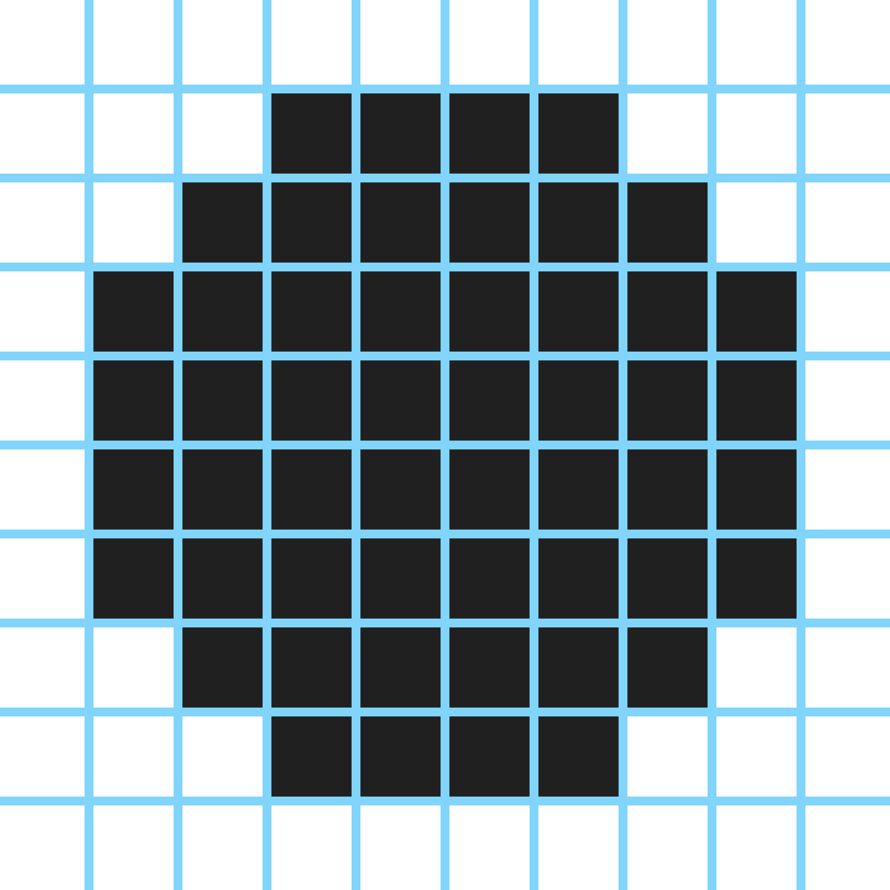
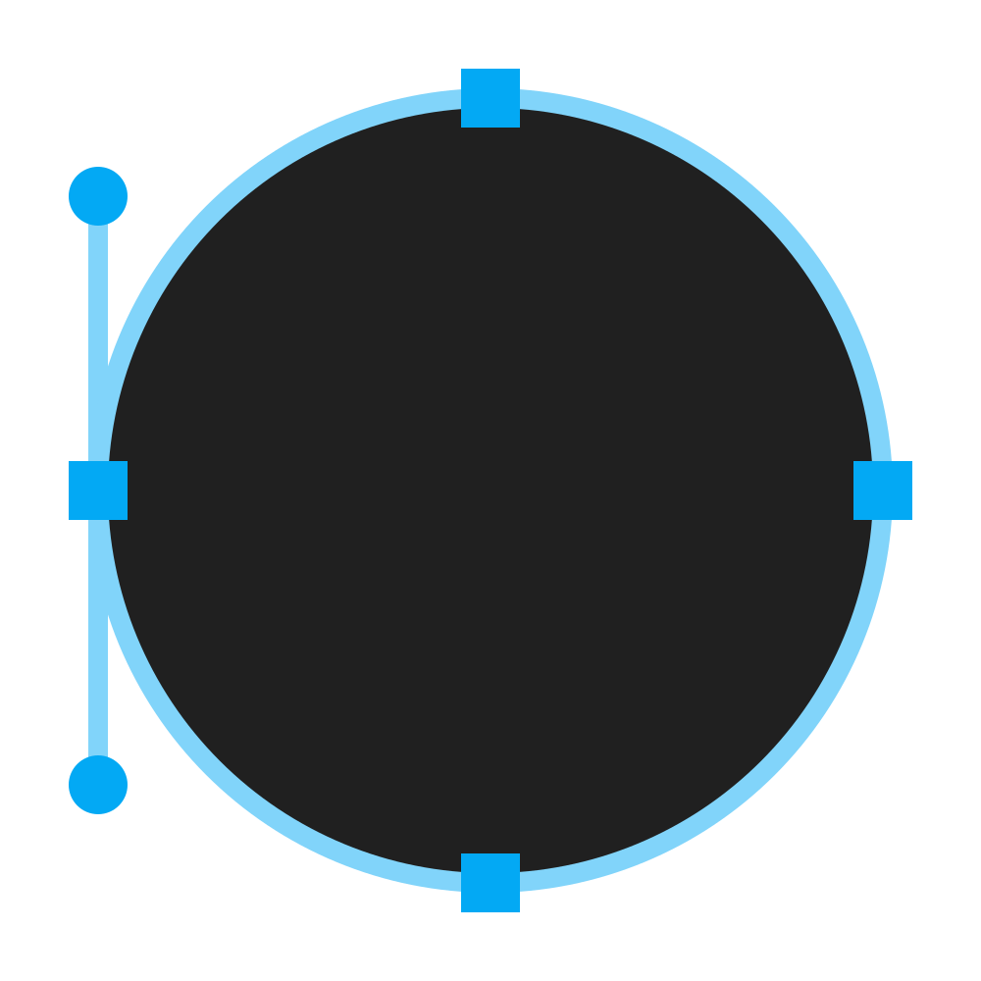
Raster vs vector
Notes:
A raster graphic is a grid of pixels.
A vector graphic is a collection primitive shapes.

Slide 4
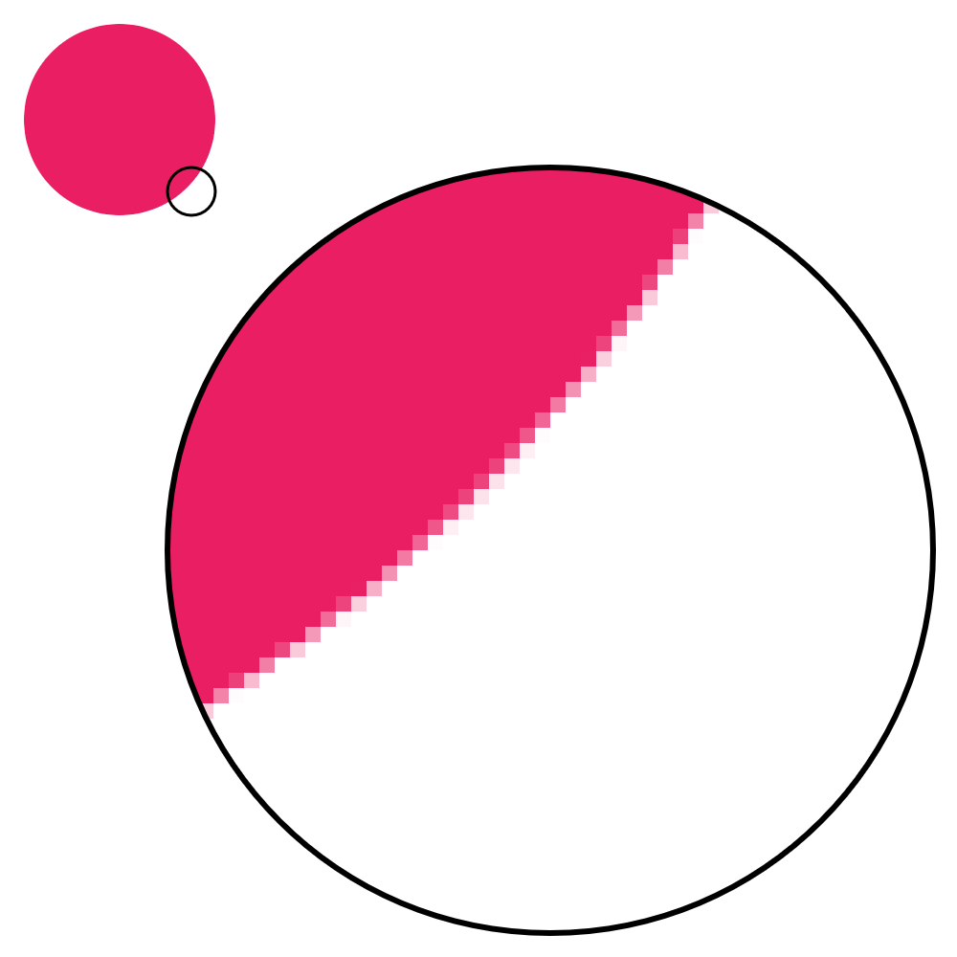

Benefits of vector graphics
Notes:
A vector graphic can be scaled to any size with perfect clarity and definition. Internally, when a program displays a vector graphic, it "renders" the shapes to a grid of pixels with the same resolution as your monitor, producing a smooth, crisp result. A raster graphic can be scaled to any size too, but requires some sort of upsampling algorithm to interpolate what should go in between the original pixels, which usually produces poor, blurry results.
In addition, vector graphics usually have a smaller file size than raster graphics, because they are defined by a few lines of text that describe shapes, rather than many rows and columns of individual pixels.
What's an example of vector graphics that almost everyone has used? __fonts__

Slide 5



Limitations of vector graphics
Notes:
Because vector graphics are drawn with primitive shapes, they are better suited to simpler, less detailed, more "geometric" images that can be drawn using basic shapes. More "photographic" images, such as realistic depictions of people, animals, etc, are usually better captured by raster images.

Slide 6


What is SVG
Notes:
SVG is the most popular vector graphic format. It was developed by the W3C, the organization in charge of defining web standards like HTML and CSS.
Cautionary:
SVG was originally aimed at the web, but it became so popular that you can now see it in a lot of other contexts too, like Word documents, PDFs, graphs, illustrations, graphic design, printed media, etc. Keep this in mind when using SVGs outside of a browser: the context you're using it in might not support all of the advanced features that a browser does, because it has essentially co-opted the technology from another platform.

Slide 7
Basics

Slide 8
How SVGs are written
<element attribute="value">
<child attribute="value">
... more content ...
</child>
<child attribute="value" />
</element>
<!-- comment -->
Notes:
SVGs are just plain text files that contain descriptions of what shapes to draw. You can create and edit them in any text editor. You can also use software like Inkscape or Adobe Illustrator to make more complex SVGs, but they are still saved and represented as plain text.
SVGs are written in a simple markup language called XML that consists of three main concepts:
1) Elements (written with "tags") - the individual components or building blocks of your image
2) Element attributes - the properties attached to an element that describes its appearance, behavior, etc
3) Element hierarchy - the organizational structure of the document, formed by arranging elements in an order or nesting them within one another
Element with children elements inside:
<element><child>...</child></element>
Element with attribute:
<element attribute="value">...</element>
Self-closing/empty element:
<element attribute="value" />
XML is generally whitespace-insensitive, so you'll see slightly different ways to format SVGs throughout this presentation and in online examples.

Slide 9
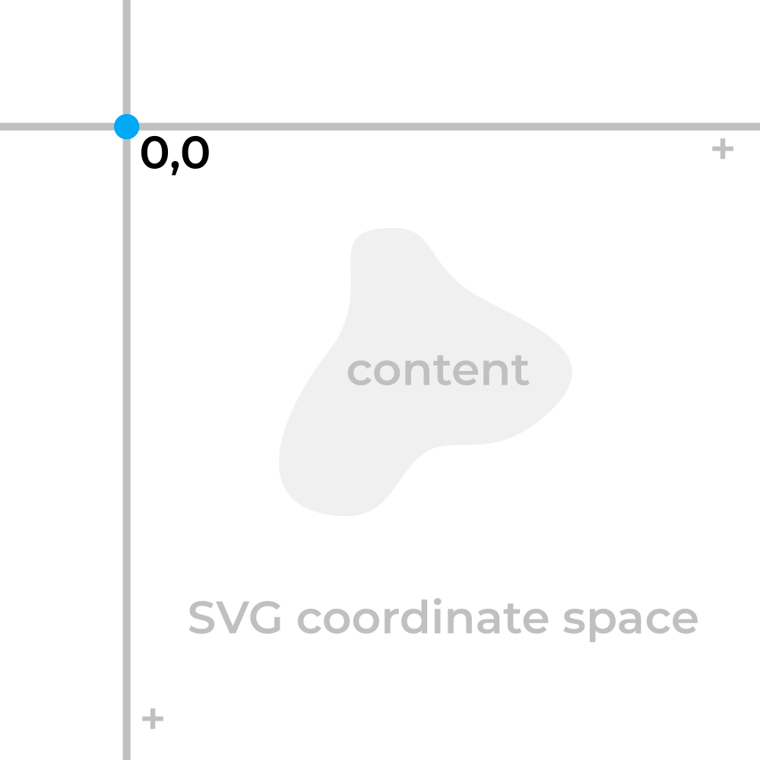
Units
Absolute
1px = 1 SVG unit
1in = 96
1cm = 37.795
1pt = 1.333
Relative
1em = current font size
Notes:
An SVG has an abstract coordinate system, measured in arbitrary units called "SVG units" or "user units". It is a consistent, Cartesian coordinate space (positive down and to the right) that eventually gets mapped to some real world space. The dimensions/positions/etc of all elements are given in this coordinate space.
It is possible to specify dimensions/positions/etc in terms of "real world units" like inches, but it is typically not advisable. Real world units will be converted to SVG units based on constants defined in the SVG standard, and the resulting actual size of the element will be affected by the viewBox, width, and height attributes, and may not actually end up as the size you intended.
Bottom line: write SVG without units. It is standard practice, and most SVG editing software seems to generate SVGs in this manner by default. It is also in line with the main purpose of SVGs, which is to create images that are independent of actual size.
Unless otherwise specified, all attributes and inputs should be given in terms of SVG units.
https://oreillymedia.github.io/Using_SVG/guide/units.html

Slide 10
The <svg> tag
<svg
xmlns="http://www.w3.org/2000/svg"
viewBox="..."
width="..."
height="..."
>
...
</svg>
Notes:
In every SVG, there is a top level <svg> element that contains all of the contents of the image and some key properties of the image. There are only 4 attributes you will likely ever use in this element: xmlns, viewBox, width, and height.
In SVGs generated by software, you will often see many other attributes and tags at or near the top-level of the document. Many of these are unnecessary, or only necessary in very specific contexts. Most likely, they are there either to support legacy browsers or versions of the SVG spec, or to provide a specific SVG editing software with supplemental metadata to aid editing. When in doubt, just remove a line and see if it still works.
The xmlns attribute is a namespace that simply tells the viewing software that the XML document is meant to be parsed as an SVG. It is always required, except in the rare case that you are including an SVG directly (inline) in an HTML document. Some advanced SVG features require you to provide additional namespaces as well.

Slide 11
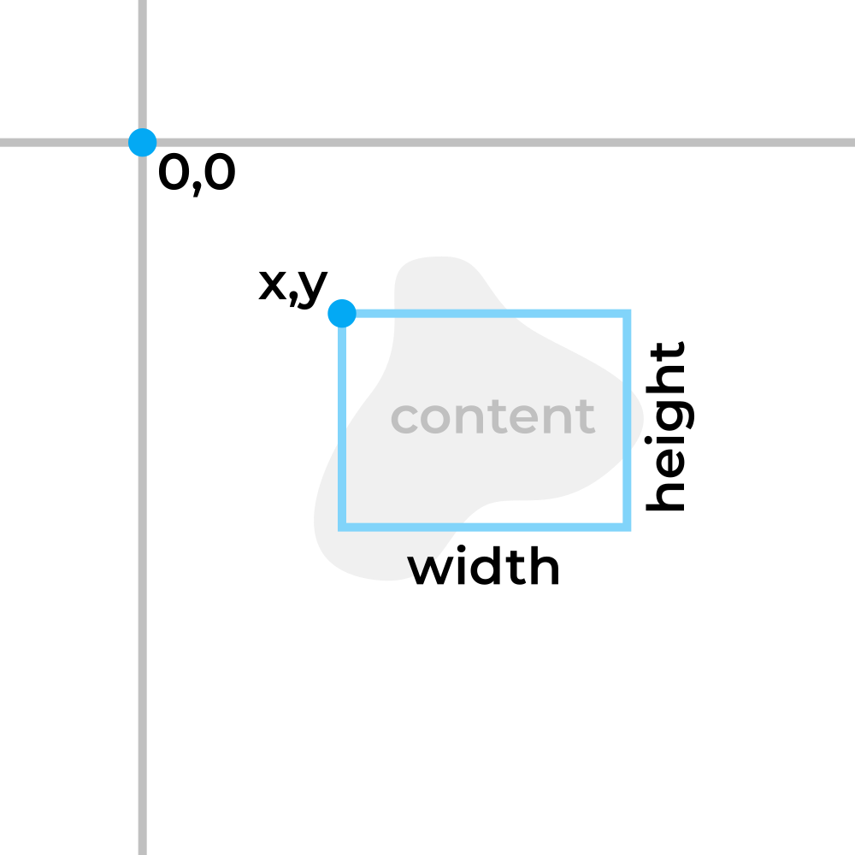
viewBox
viewBox="x y width height"
viewBox="70 60 100 75"
Notes:
The viewbox is the window into the SVG's coordinate space, and defines the boundaries of the image. You can think of it like a camera or a frame. You specify the x/y coordinates of the upper left corner and the width/height of the viewbox, in SVG units.
Contents of the SVG can extend beyond the viewbox, which you may or may not be able to see depending on the software and the overflow property.
viewBox should always be specified; weird things can happen if it isn't.

Slide 12
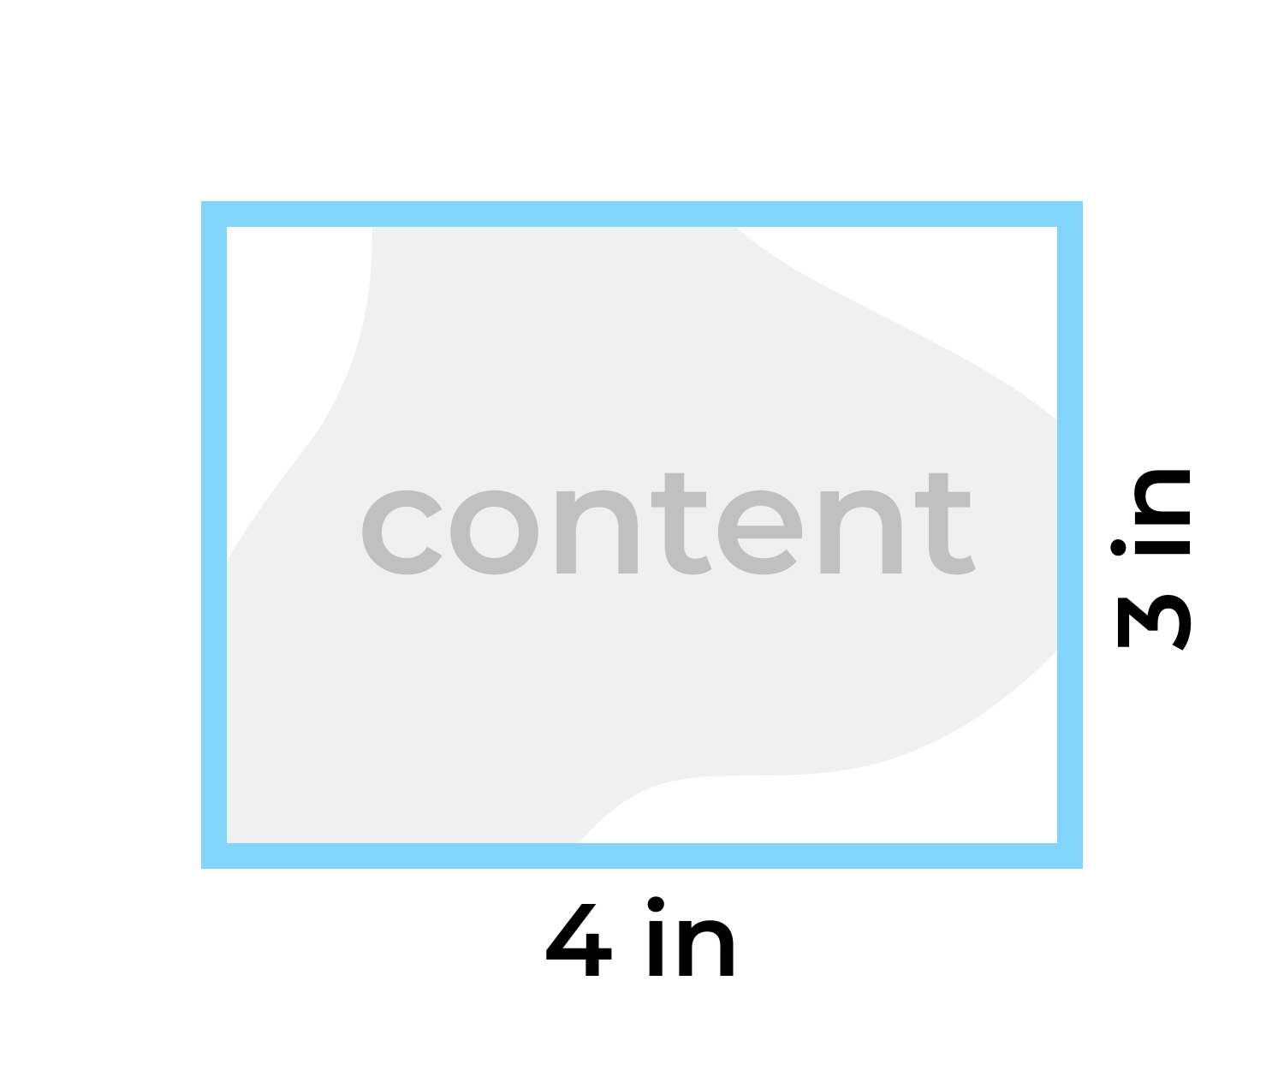
Width and height
width="..." height="..."
width="4in" height="3in"
Notes:
The width and height attributes specify how large the image should appear in its final context. Along with viewBox, it essentially defines a mapping from SVG units to real world units.
This is the only place in your SVG where you can specify real world units. If no unit is specified, they are interpreted as pixels.
If these attributes are omitted entirely, default behavior will vary from software to software. Browsers will usually scale the image to fit the dimensions of its container. Some software may make them the same as the viewbox width/height in pixels.
In practice, it is usually more useful to not hard-code these attributes into the SVG, and to simply scale the image in situ to the needed size (eg, in CSS for a webpage, or in Inkscape before rendering as a PNG). As such, the minimum/boilerplate code to form a valid SVG is an <svg> element with the xmlns and viewBox attributes.

Slide 13
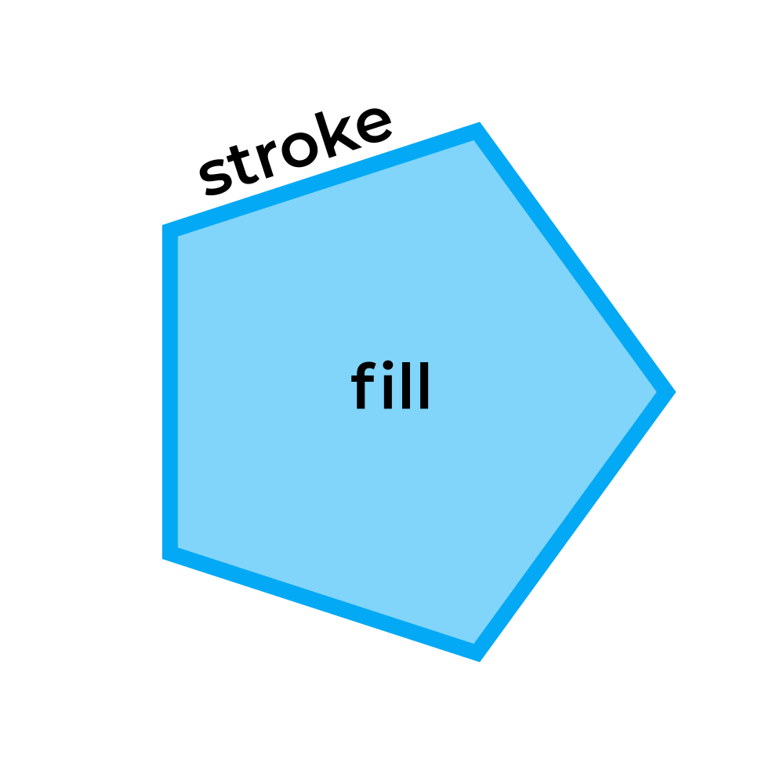
Stroke and fill
fill="..." stroke="..."
fill="skyblue" stroke="blue"
Notes:
Before getting into drawing basic shapes, it is necessary to understand the stroke and fill attributes. The stroke is the outline of a shape, and the fill is the area within a shape. Both attributes can be set to a color, or to none to be disabled.
By default, SVG shapes have fill="black" and stroke="none"; even shapes that are intended to be just strokes, like lines. You will likely have to override this frequently.
By default, the stroke is shown in front of the fill. Unfortunately, there isn't a reliable, fully accepted way (for all browsers and software) to switch this order.

Slide 14

Color
 | Normal, opaque | With transparency
Named | red | -
Hex | #ff0000 | #ff000080
Red, Green, Blue | rgb(255, 0, 0) | rgba(255, 0, 0, 0.5)
Hue, Saturation, Luminance | hsl(0, 0%, 100%) | hsla(0, 0%, 100%, 0.5)
Notes:
HSL splits colors into hue (red vs green vs purple), saturation (how "much" color there is, black/white vs colorful), and luminance/brightness (dark vs light).
RGB splits colors into red/green/blue "components", between 0 and 255 (256 possible values). Balance the components in different proportions to get different hues. Increase/decrease all of the components to increase/decrease the brightness. All 0's = black, all 255's = white.
Hex is just a more compact way to write RGB. The 0 to 255 range is compressed down to 2 hex digits, each with 16 possible values (0, 1, 2, 3, 4, 5, 6, 7, 8, 9, A, B, C, D, E, F). The first two digits represent red, the next two green, and the next two blue. Hex colors are the most common way to write colors in web technologies.
Regular (English) color names, like "red" or "violet", can also be used.
Non-named colors can also accept an additional alpha parameter at the end, which will blend it with whatever content is behind it.
https://www.materialpalette.com/colors
https://htmlcolorcodes.com/color-chart/
http://colormind.io/
http://www.gradients.io/

Slide 15
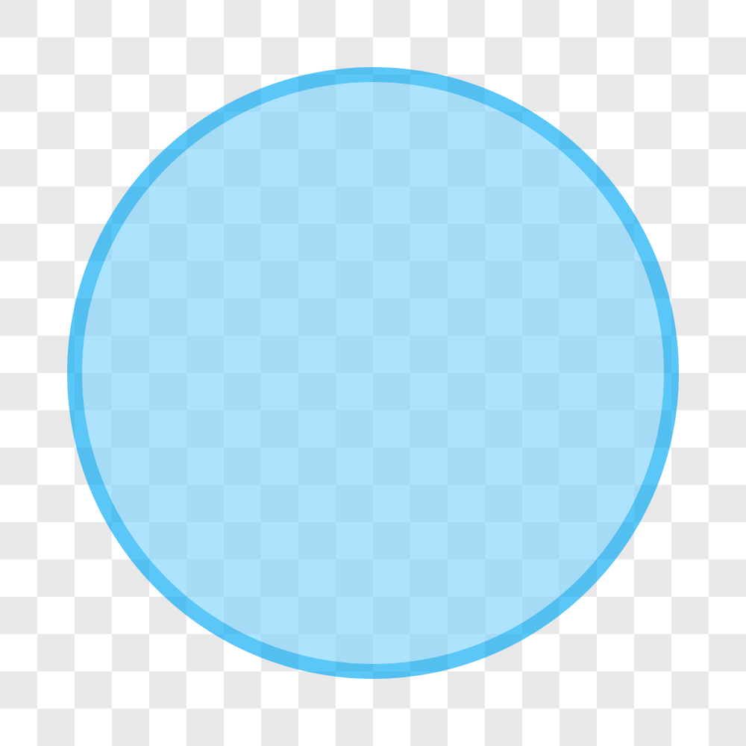
Opacity
opacity="..."
Notes:
An element's opacity defines how much it will blend in with whatever content is behind it, on a scale of 0 to 1. An opacity of 1 will make an element completely opaque; 0 completely invisible; 0.5 half-way translucent.
There are also fill-opacity and stroke-opacity attributes to set the transparency of the fill and stroke separately, but they are not broadly supported yet. Use with caution.

Slide 16
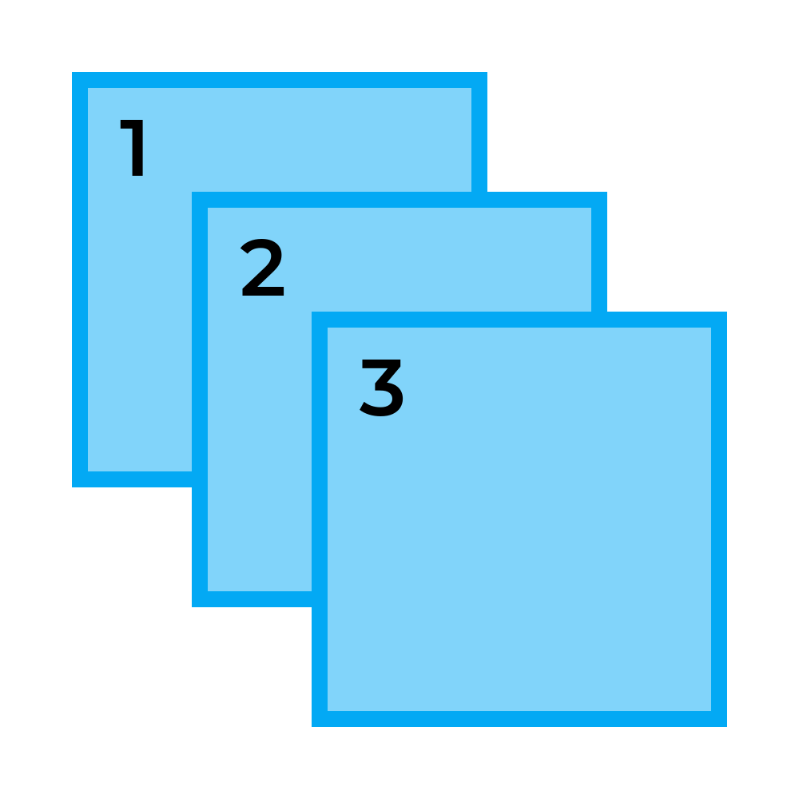
Z-order
<!-- 1 -->
<rect />
<!-- 2 -->
<rect />
<!-- 3 -->
<rect />
Notes:
Elements are stacked in the order they appear in your SVG document. Later defined elements are stacked on-top/in-front of earlier defined elements.

Slide 17
Basic Shapes

Slide 18
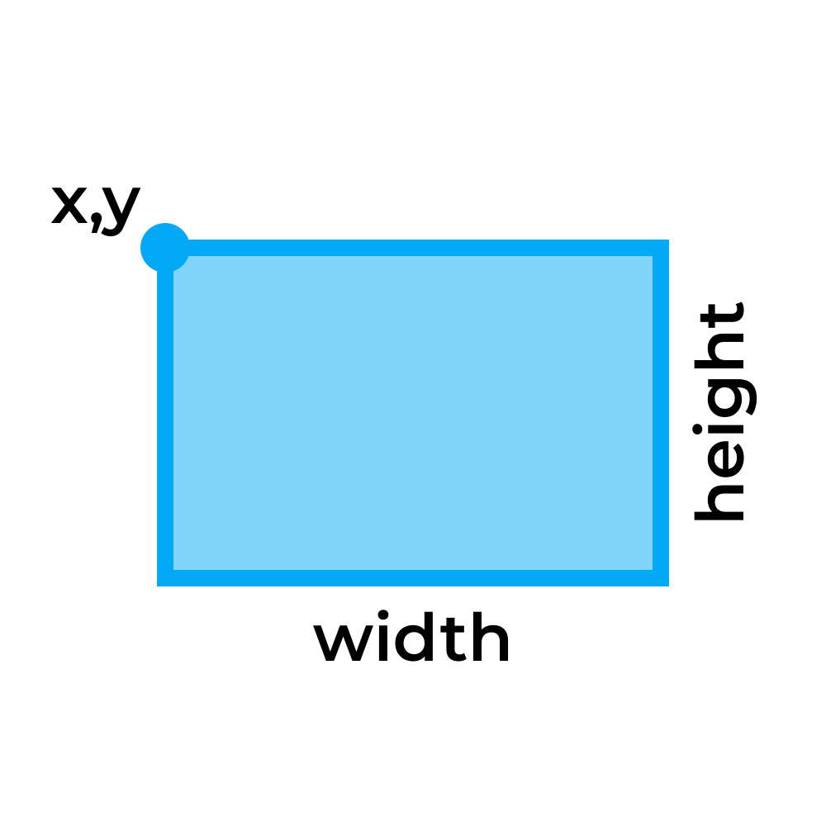
Rectangle
<rect
x="..."
y="..."
width="..."
height="..."
/>

Slide 19
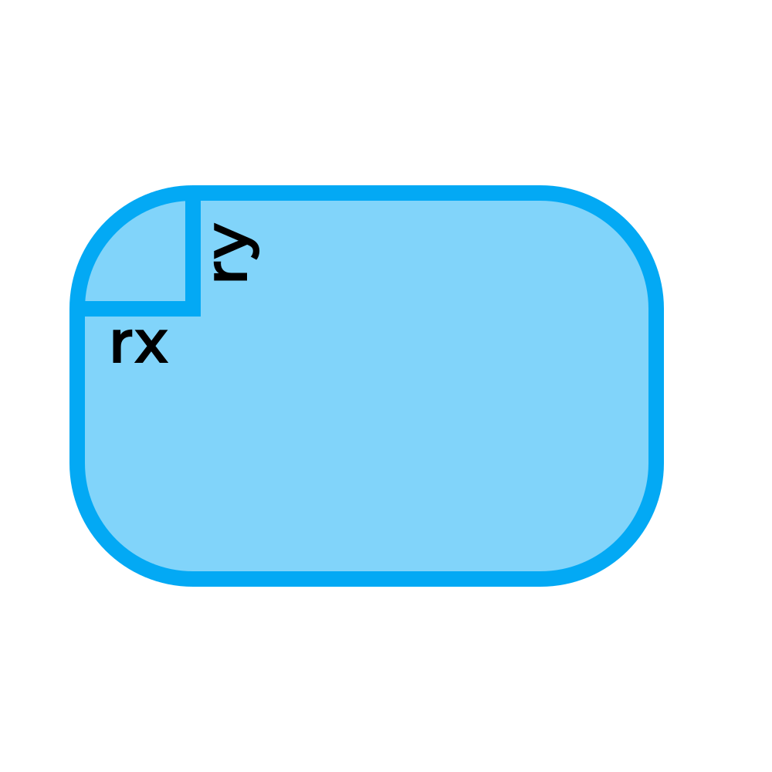
Rounded rectangle
rx="..."
ry="..."
Notes:
A rounded rectangle is written in the same way as a regular rectangle, but with the added rx and ry attributes that specify the corner radius. The width and height attributes still refer to the full outer width and height of the shape.

Slide 20
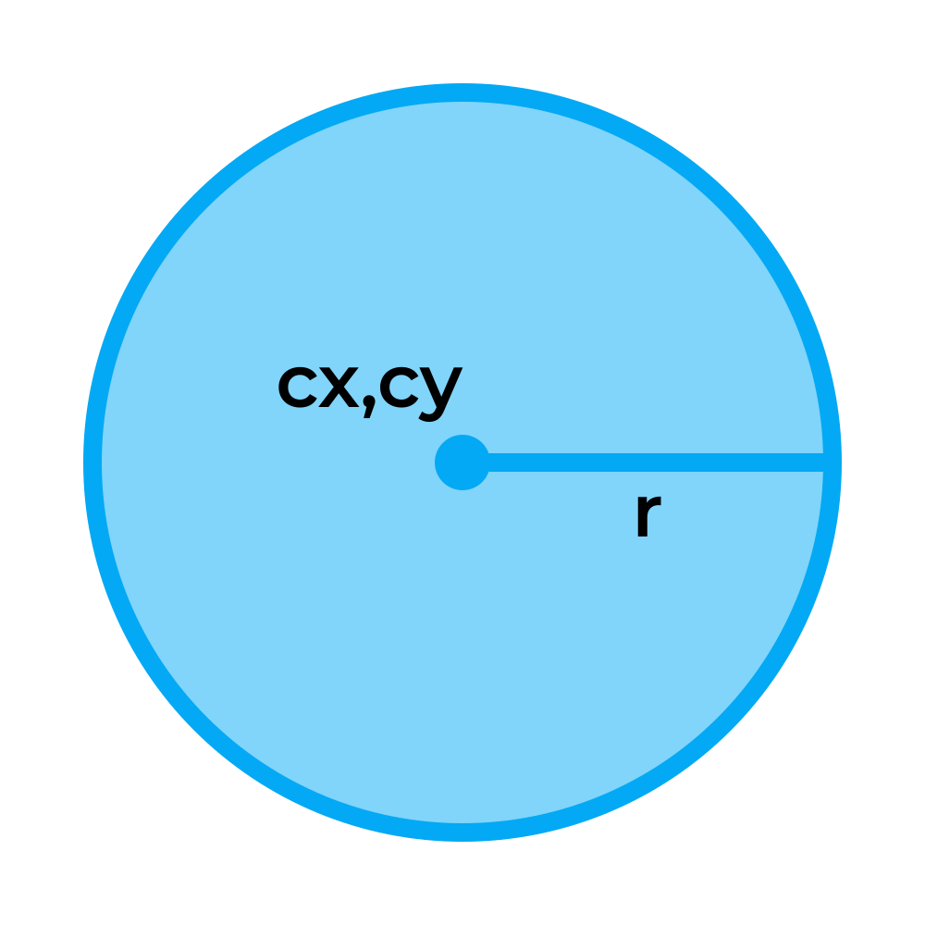
Circle
<circle
cx="..."
cy="..."
r="..."
/>

Slide 21
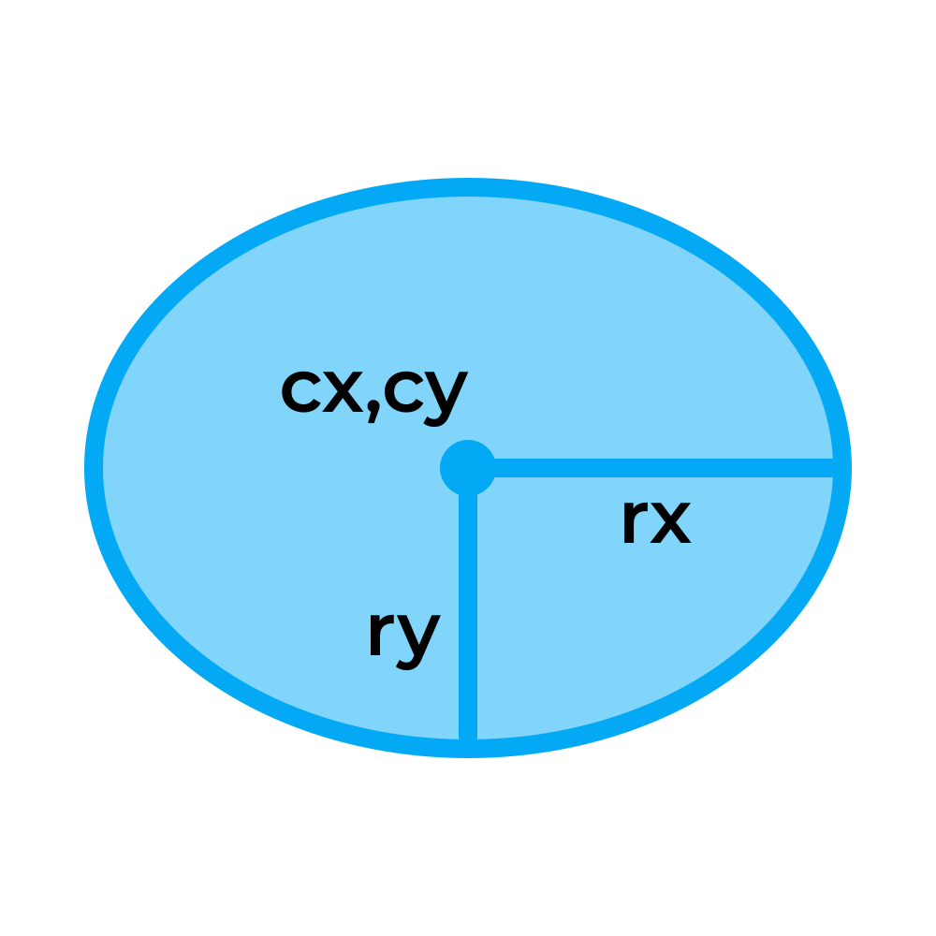
Ellipse
<ellipse
cx="..."
cy="..."
ry="..."
rx="..."
/>

Slide 22
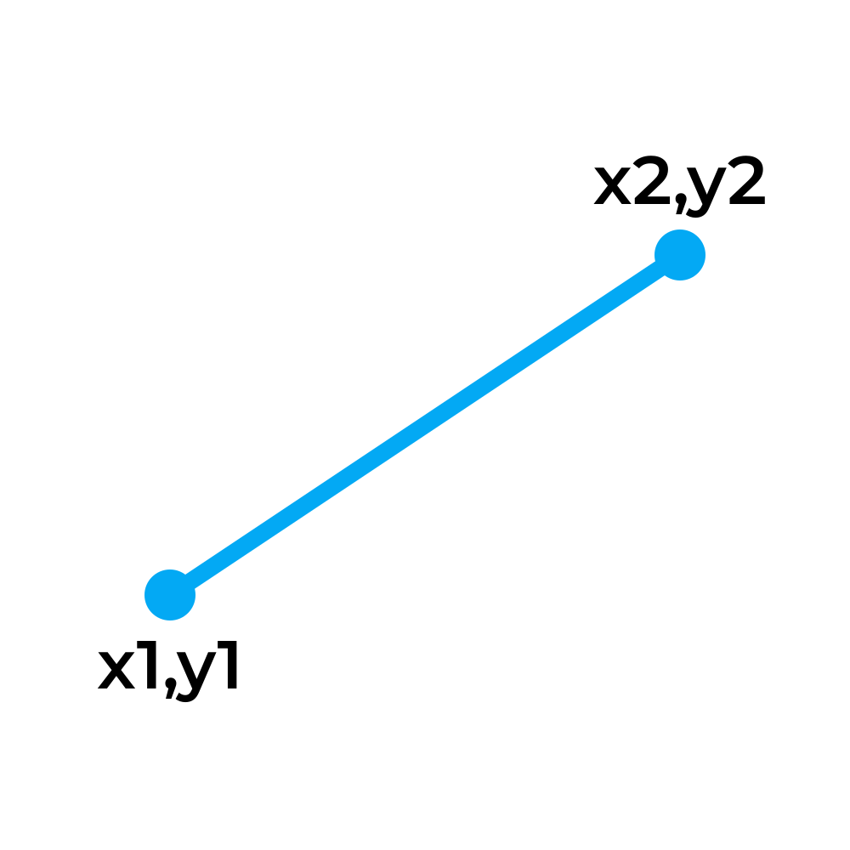
Line
<line
x1="..."
y1="..."
x2="..."
y2="..."
/>

Slide 23
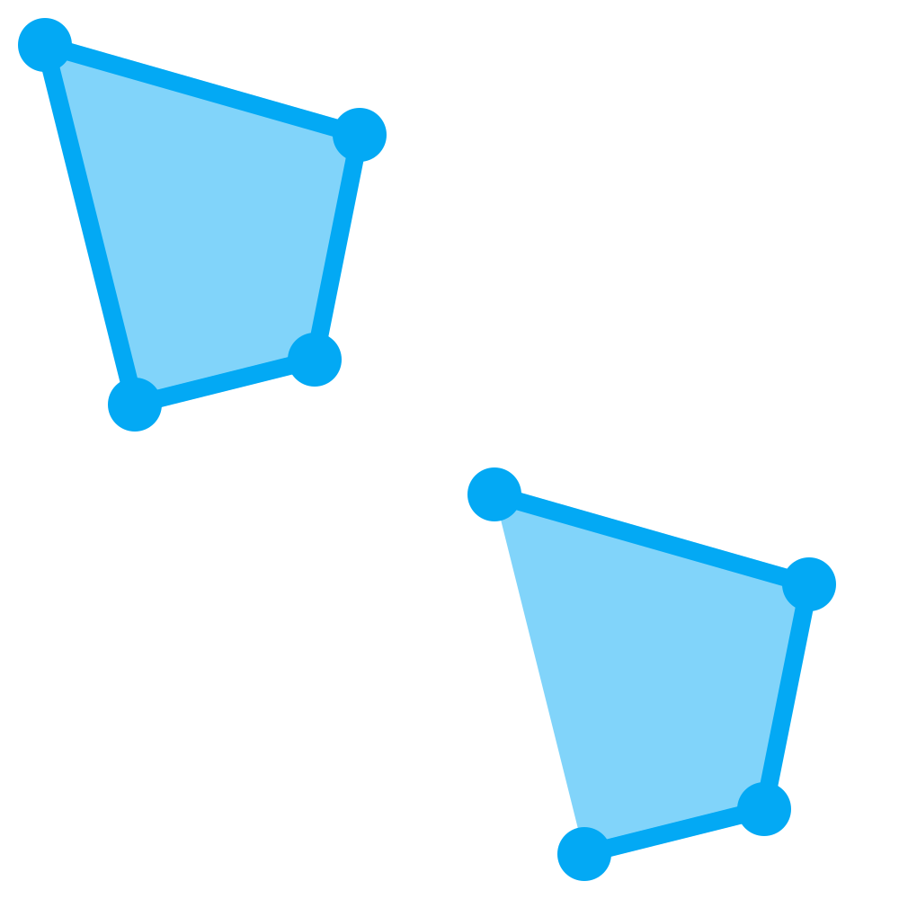
Polygon / polyline
<polygon/polyline
points="... x y x y ..."
/>
Notes:
A <polygon> element is intended for closed shapes, where the last point is automatically connected to the first. A <polyline> element is intended for multi-segment lines (open shapes), and is not automatically closed. For the points attribute, specify a series of x/y coordinates, separated by single space or comma.
Note that if a fill is specified for an open shape, it will still be filled and essentially look as if it has been closed, except the last stroke segment will be missing.

Slide 24
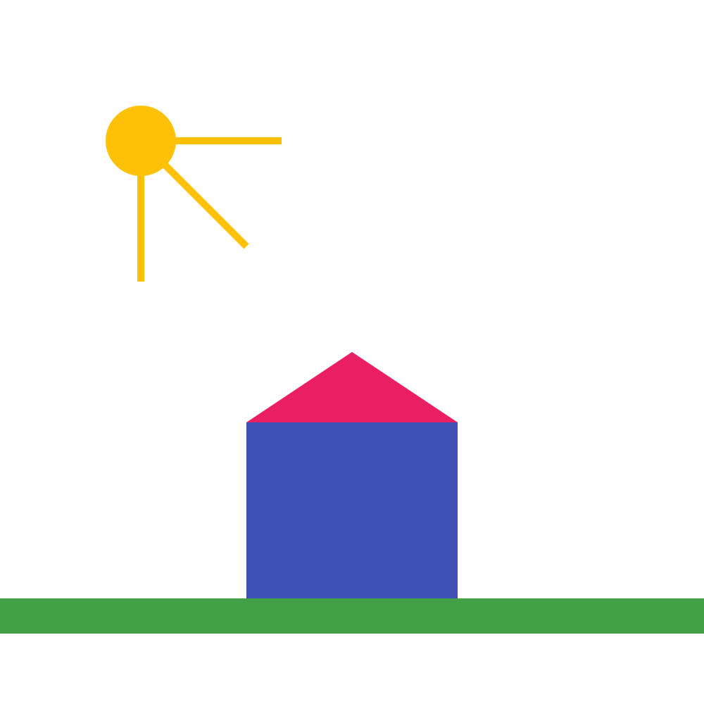
Exercise 1
Notes:
Recreate this SVG on your own using the techniques covered so far. The exact colors, lengths, and dimensions are not important; just try to capture the basic picture.

Slide 25
Strokes

Slide 26
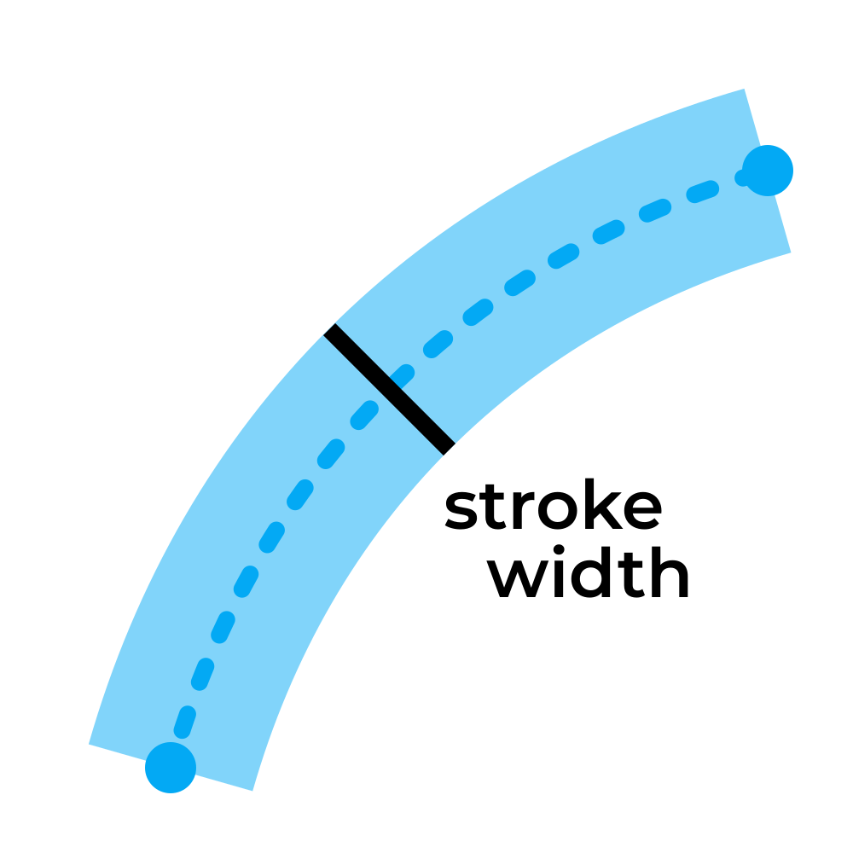
Stroke width
stroke-width="..."
Notes:
The stroke-width attribute specifies the thickness of the stroke around an element. Note that the stroke is always applied "on center" with the outline of the element. Half of the stroke width will be applied on one side of the outline, and the other half on the other side. The outline (center of the stroke) is exactly where you specify it in the geometry of your shape.
Unfortunately, there is no reliable, standard way to set the stroke to be on the inside or the outside of the outline. You will either have to adjust your geometry points to account for the thickness you want, or use a program like Inkscape or Illustrator to help you achieve the desired effect more conveniently.

Slide 27
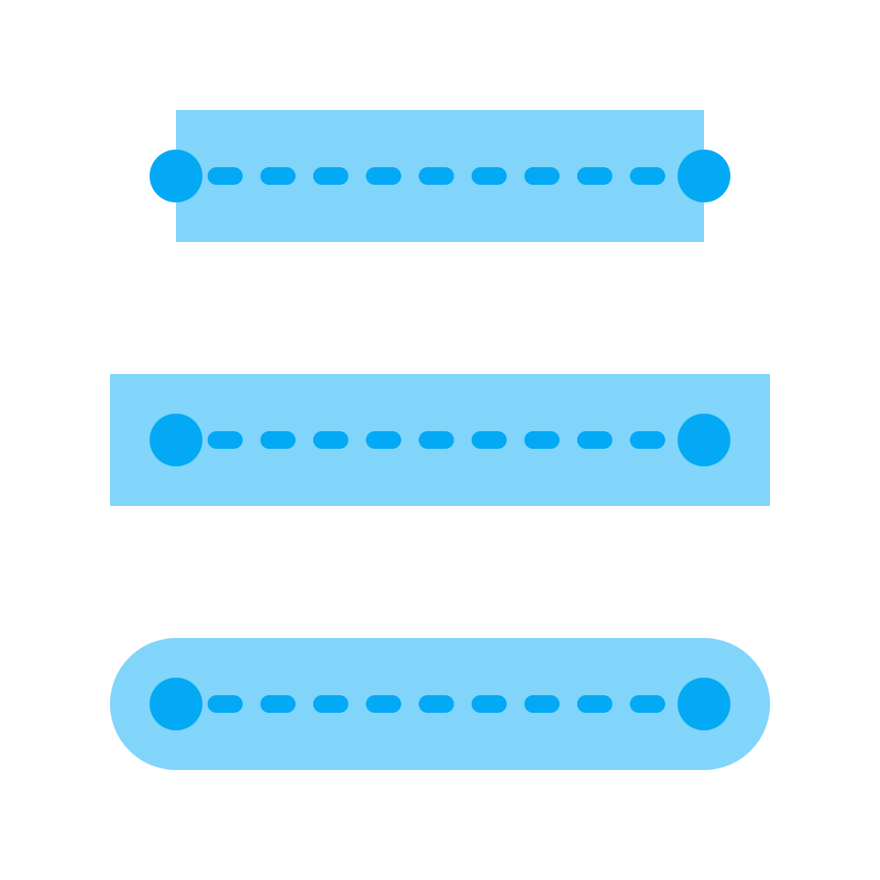
Stroke line cap
stroke-linecap="butt"
stroke-linecap="square"
stroke-linecap="round"
Notes:
The stroke-linecap attribute specifies how the strokes of unclosed shapes look at their ends. "Butt" is the default; it specifies that the stroke ends flush with the end of the outline. "Square" specifies that that stroke extends beyond the end of the outline a distance of half the stroke thickness, creating the appearance of a square centered on the end point. "Round" is the same as "square", except the the stroke is rounded creating the appearance of a circle centered on the end point.

Slide 28
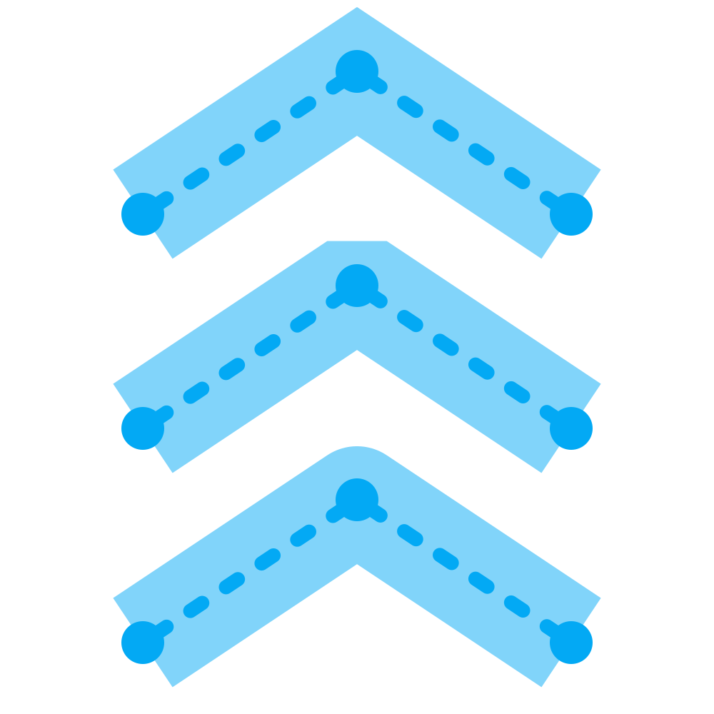
Stroke line join
stroke-linejoin="miter"
stroke-linejoin="bevel"
stroke-linejoin="round"
Notes:
The stroke-linejoin attribute specifies how consecutive segments of a stroke are joined. "Miter" is the default; it extends the edges of the stroke until they intersect, and fills the enclosed area. "Bevel" treats the segments as if they were "butt" caps, and fills the resulting gap between them. "Round" treats the segments as if they were "round" caps.
The stroke-miterlimit attribute can be used to make a "miter" join by default, but make a "bevel" join where the joint angle is too sharp (to avoid a long point jutting out).
https://www.w3.org/TR/svg-strokes/ Fig. 10

Slide 29

Dashed lines
stroke-dasharray="d g d g ..."
stroke-dasharray="10"
stroke-dasharray="20 10"
stroke-dasharray="20 10 5 10"
Notes:
The stroke-dasharray attribute allows you to create custom dash patterns for strokes. The attribute is specified as a series of alternating dash and gap lengths, starting with the first dash length.
If you only provide one value, the dash and gap values will be the same. In reality, when an odd number of values is provided, the sequence is duplicated once to yield an even number; but this results in unintuitive behavior, and is not recommended for best clarity.

Slide 30
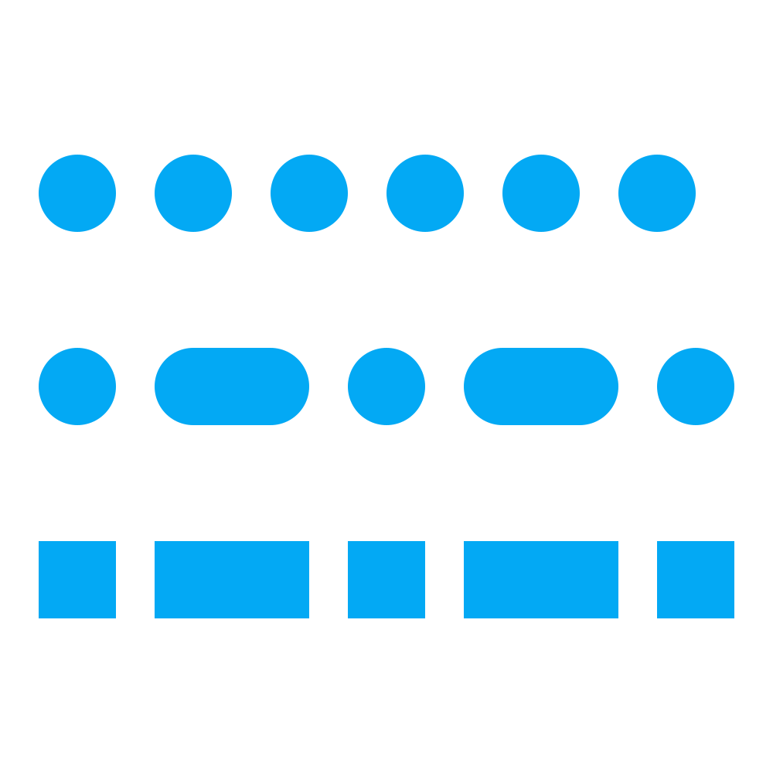
Dotted lines
stroke-dasharray="0 15"
stroke-dasharray="0 15 10 15"
stroke-dasharray="0 15 10 15"
Notes:
By setting stroke-linecap to "round" or "square" and using 0-length dashes, you can create dotted lines.

Slide 31

Dash offset
stroke-dashoffset="0"
stroke-dashoffset="-5"
stroke-dashoffset="-10"
Notes:
By default, the dash pattern begins at the starting point of the stroke. The stroke-dashoffset attribute shifts the dash pattern toward the end point (negative) or toward the start point (positive).

Slide 32

Exercise 2
Notes:
Recreate this SVG on your own using the techniques covered so far. The exact colors, lengths, and dimensions are not important; just try to capture the basic picture.

Slide 33
Text

Slide 34
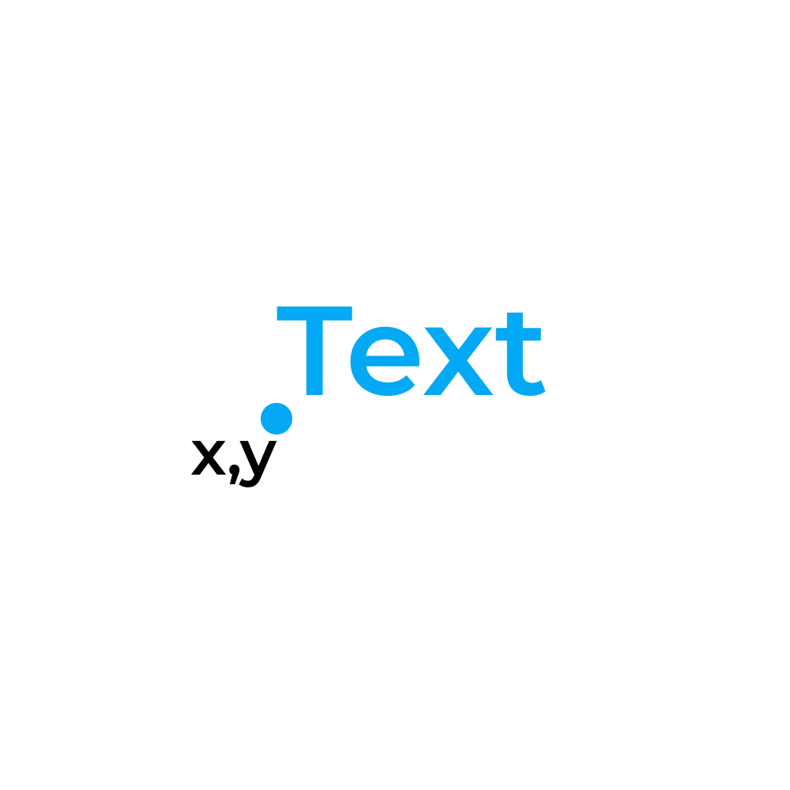
Text
<text
x="..."
y="..."
>
Text
</text>
Notes:
Text is one of the most painful things to deal with in SVG. Text will display inconsistently on different platforms and software, especially with regard to alignment. To guarantee they will always look as expected, convert text to raw shapes using SVG software (eg Inkscape's "Object to path" functionality).
For posterity, it is a good idea to either leave in the original <text> element commented out, or just make a comment noting the font/size/style you used to generate the text.

Slide 35

Text style
font-family="Montserrat"
font-size="16"
font-weight="bold"
font-style="italic"
text-decoration="underline"
letter-spacing="5"
Notes:
If the specified font family isn't installed, a system default will be used. Special note: it is possible to specify an order of fallback fonts, including a generic type (eg serif, sans-serif, monospace). You most likely won't need to use this, but keep it in mind.
The font-weight attribute can be set to "normal" (default), "bold", "bolder", "lighter", or a multiple of 100 between 100 and 1000 (400 is normal, 700 is bold).
You may see these attributes specified in different ways, as we will cover later.

Slide 36
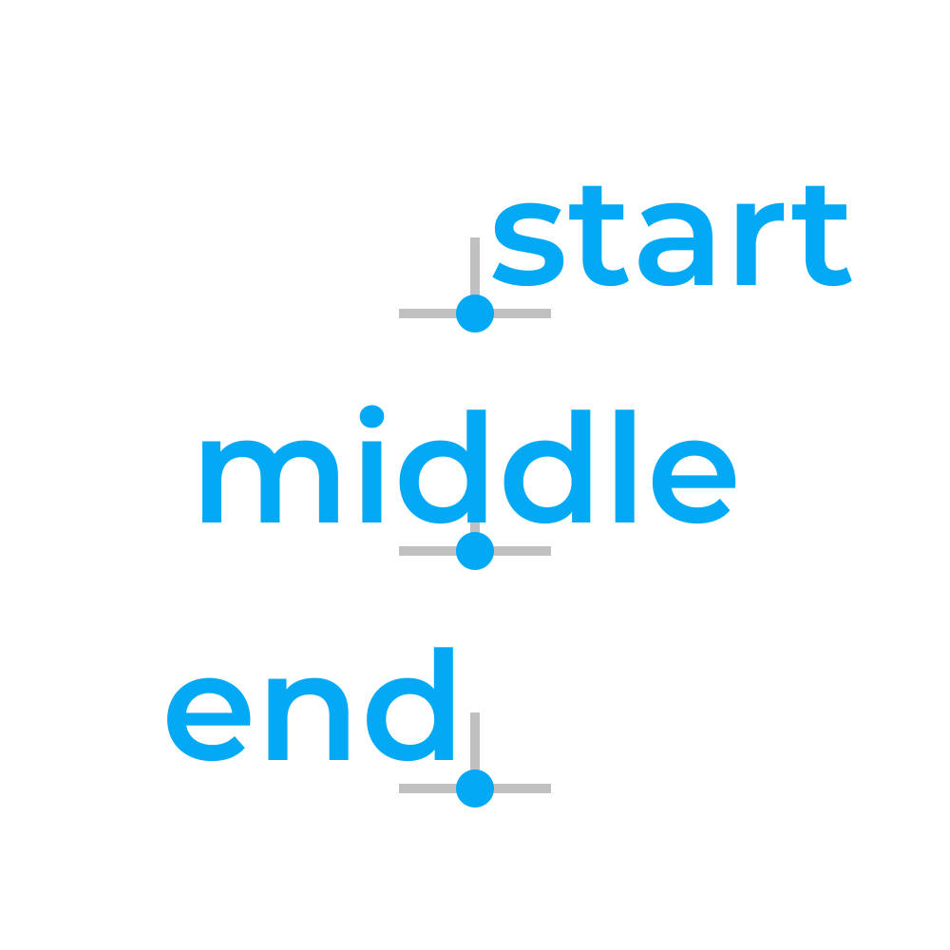
Text horizontal align
text-anchor="start"
text-anchor="middle"
text-anchor="end"
Notes:
Default is "start".

Slide 37
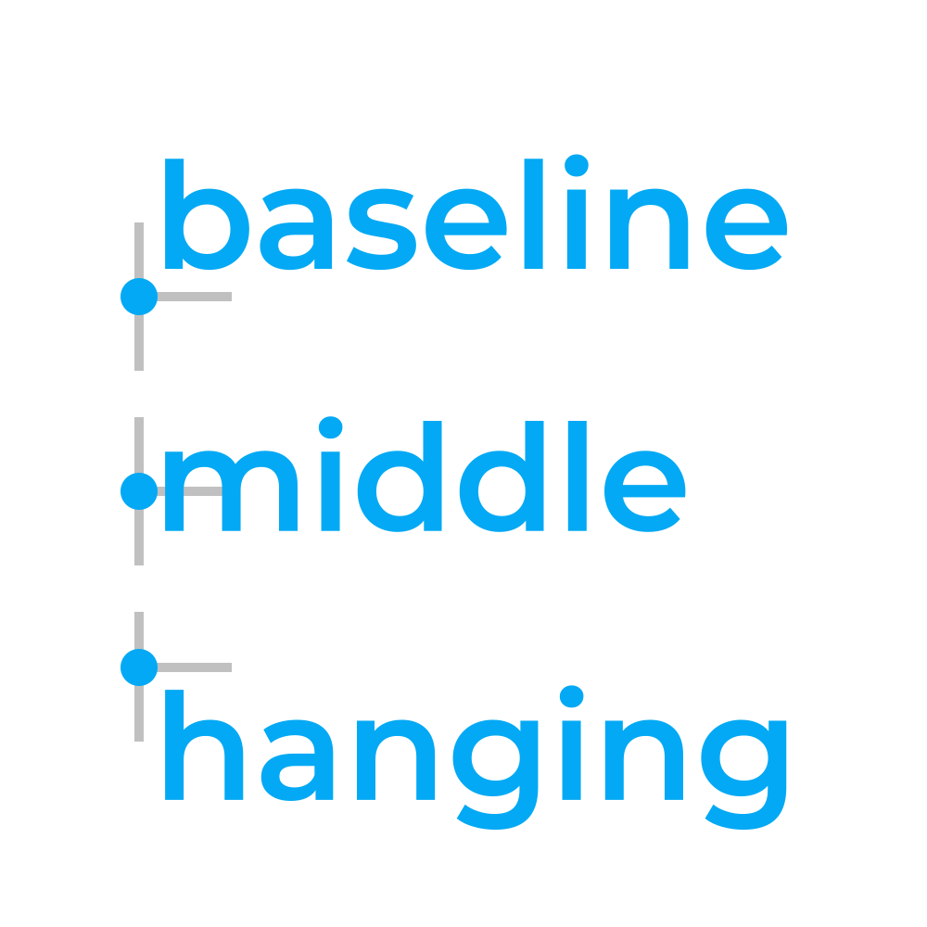
Text vertical align
dominant-baseline="baseline"
dominant-baseline="middle"
dominant-baseline="hanging"
Notes:
Default is "baseline".
Don't confuse this with the alignment-baseline attribute, which is similar but not quite the same.

Slide 38

<tspan>
<text>
grumpy
<tspan fill="#e91e63">
cat
</tspan>
</text>
Notes:
<tspan> elements can be placed inside <text> elements to style individual words/strings without breaking the normal flow of text.

Slide 39
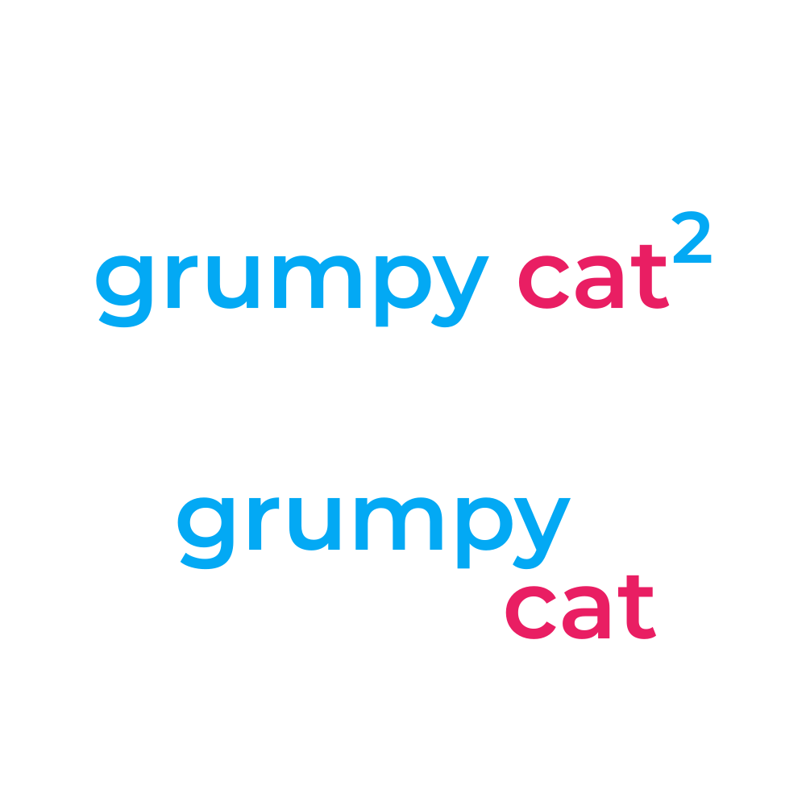
<tspan> offset
baseline-shift="super"
baseline-shift="sub"
dx="..."
dy="..."
Notes:
<tspan> elements can be positioned normally with x and y, but can also be positioned relative to the preceding text using the dx and dy attributes. Note that using these attributes offsets all of the following text as well as the element it is applied to. You can think of it as moving a typing cursor; once you move it, the next text that comes in will start at that position.
The baseline-shift attribute can be used to quickly create a superscript or subscript without affecting the text after it.
Remember, "em" can be used as a font size unit to specify a size relative to the current font size. For example, you may want to set font-size="0.75em" on a superscript element to make it 75% the size of the normal text.
Unfortunately, there is no reliable way to auto-wrap text in SVG. You will have to manually break text at the desired places and position lines beneath one another.

Slide 40

Exercise 3
Notes:
Recreate this SVG on your own using the techniques covered so far. The exact colors, lengths, and dimensions are not important; just try to capture the basic picture.

Slide 41
Paths

Slide 42

Paths
<text
d="..."
fill="..."
stroke="..."
/>
Notes:
<path> elements can be used to create arbitrary shapes that behave like any of the standard shapes (with regard to fill, stroke, opacity, etc). The geometry of a path is specified in its d (description) attribute.

Slide 43
Path d syntax
M 50 50 L 100 100 C 75 100, 50 75, 50 50
M 50,50 L 100,100 C 75,100 50,75 50,50
M 50 50
L 100 100
C 75 100 50 75 50 50
Notes:
The d attribute takes a sequence of draw commands. You can think of these commands as moving a paint brush around a canvas. Each command is a single letter, and can be followed by numerical values to specify where and how to draw the command.
The syntax of these commands is similar to that of the points attribute for polygons and polylines. Values can be separated by a single space or single comma. Letters next to numerical values do not need to be separated at all, because they can be differentiated by the parser just by their type (whereas "10,10" can't be condensed to "1010" without looking like one thousand and ten). Line breaks are also permitted.
As such, there are many different ways to format the same path string. However, for best clarity, separate commands by line, and separate command values by space

Slide 44
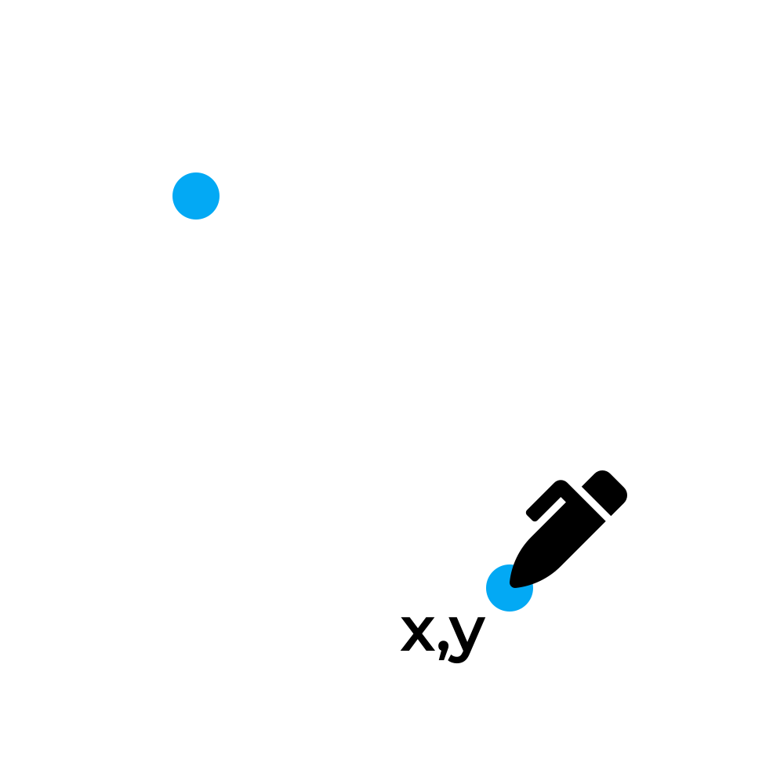
Move to
M x y
Notes:
The "M" command moves the brush to the specified point without drawing anything between.

Slide 45
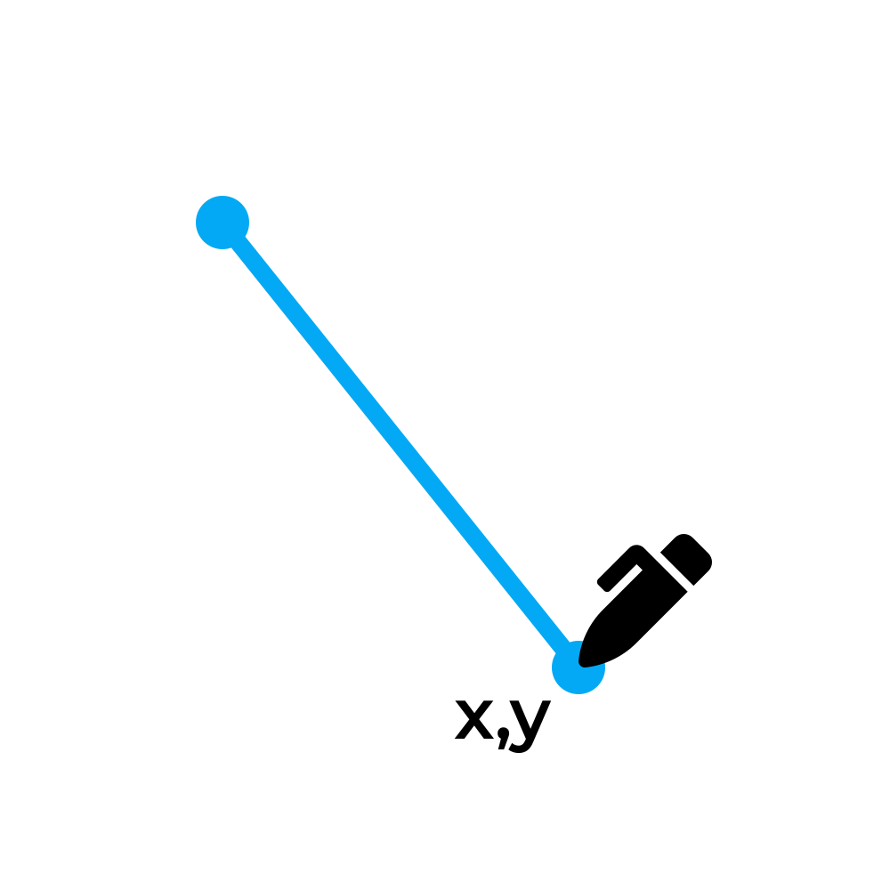
Line to
L x y
H x
V y
Notes:
The "L" command draws a straight line from the previous point to the specified point.
The "H" and "V" commands draw horizontal and vertical lines, respectively, from the previous point to the specified x or y coordinate.

Slide 46
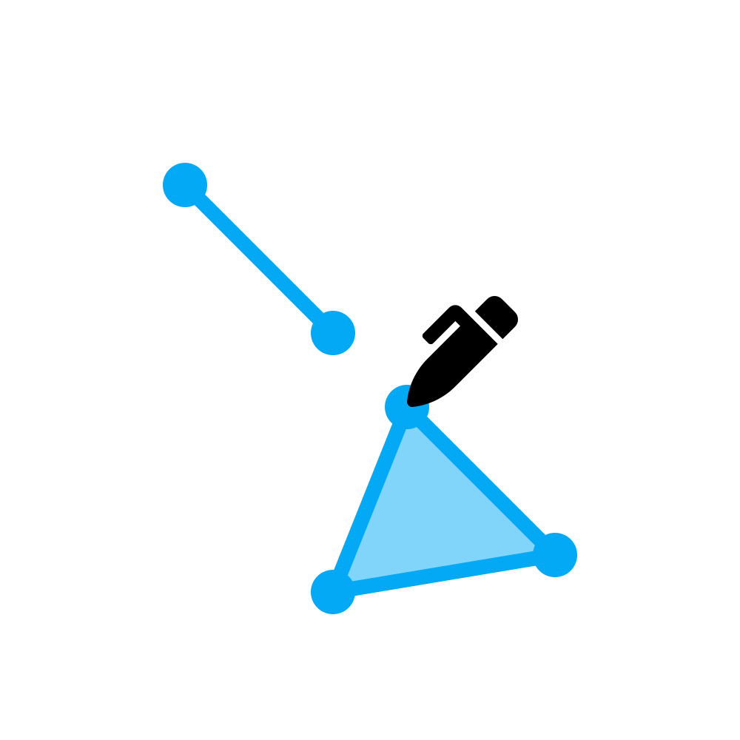
Close
M 25 25
L 45 45
M 55 55
L 75 75
L 45 80
Z
Notes:
The "Z" command closes the current shape, drawing a line back to the first point.
Because of the "move to" command, it is possible to draw multiple filled shapes within the same path element, called "subpaths". The "Z" command closes the current subpath.

Slide 47
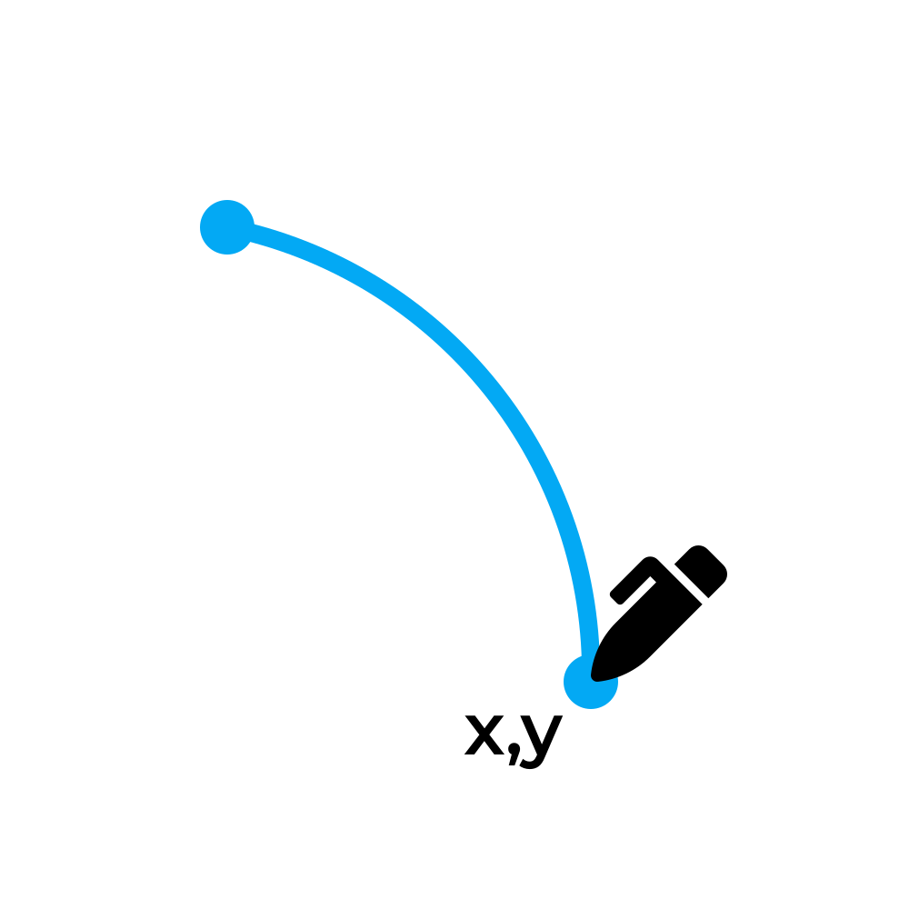
Arc to
A rx ry angle large cw x y
A 50 50 0 0 1 65 75
Notes:
The "A" command draws an elliptical arc from the current point to the specified point.
You might expect that arcs would work by specifying the center point and start and end angles. Instead, it works from point to point, and you choose 1 of 4 possible arcs between them. This unfortunately means that if the start/end angles you want to draw aren't multiples of 90 degrees, you'll have to do some trigonometry to calculate coordinates, and you'll end up with a lot of non-whole numbers.
https://developer.mozilla.org/en-US/docs/Web/SVG/Tutorial/Paths
https://codepen.io/lingtalfi/pen/yaLWJG

Slide 48
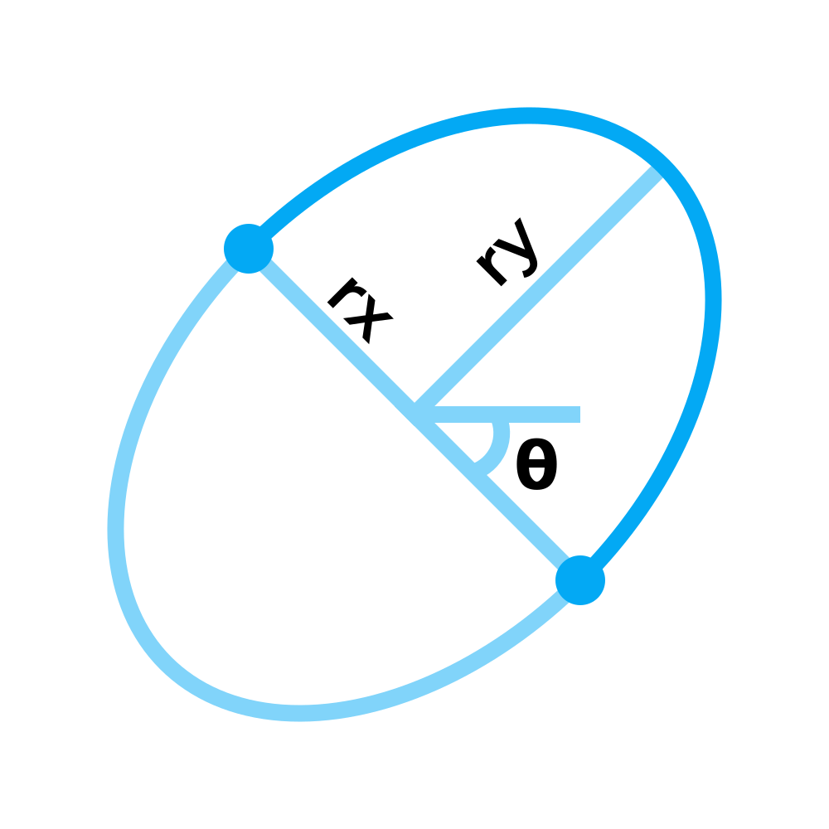
Arc to - radius and angle
A rx ry angle large cw x y
Notes:
The "rx" and "ry" inputs specify the x and y radii of the ellipse that forms the arc. The angle input specifies the rotation of the ellipse that forms the arc; clockwise, in degrees, from the positive x axis.

Slide 49
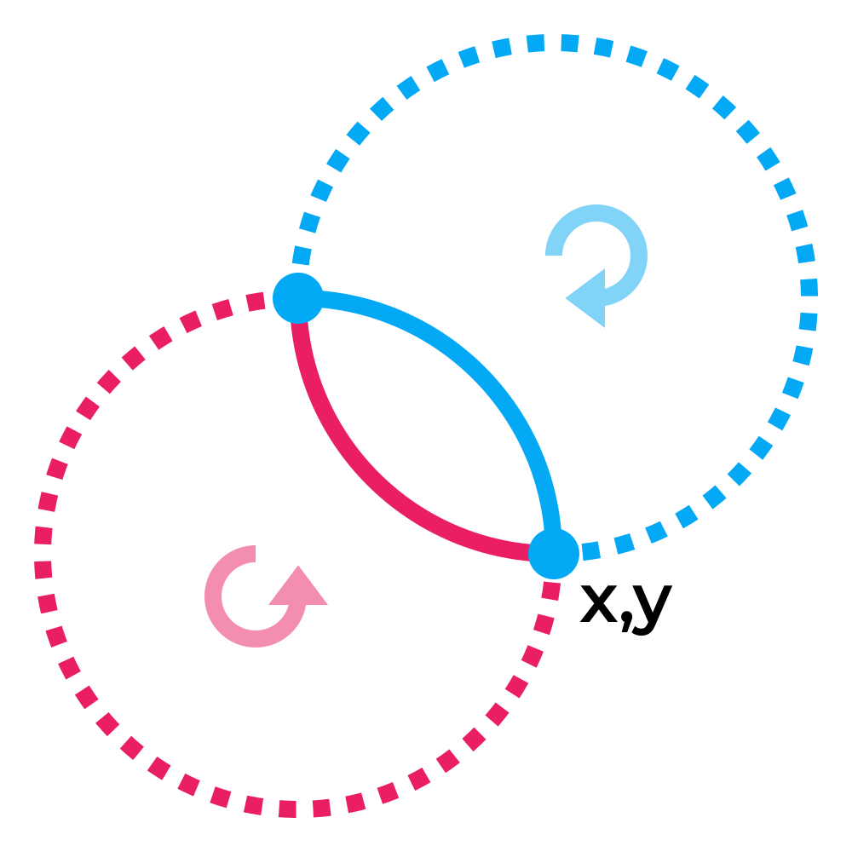
Arc to - flags
A rx ry angle large cw x y
Notes:
Given a radius, there are 4 possible arcs that can be drawn between two points. The "large" and "cw" (often called the "large arc" and "sweep" flags) inputs allow you to specify which of the 4 possible arcs should be used. These inputs should be set to 0 (for false) or 1 (for true).
When "large" is set to 1, the outer/larger arc is used (shown as dotted lines above). When "large" is set to 0, the inner/smaller arc is used (shown as solid lines above).
When "cw" is set to 1, the arc that represents a clockwise rotation around the center is used (shown as blue above). When "cw" is set to 0, the arc that represents a counter-clockwise rotation around the center is used (shown as red above). Imagine driving a car along the arc from start point to end point. If you have turn right the whole time, the "cw" flag is 1. If you have to turn left the whole time, the "cw" flag is 0.
If the radii you've specified aren't large enough to create an arc to the specified point, they are increased (maintaining proportions) until they are.

Slide 50
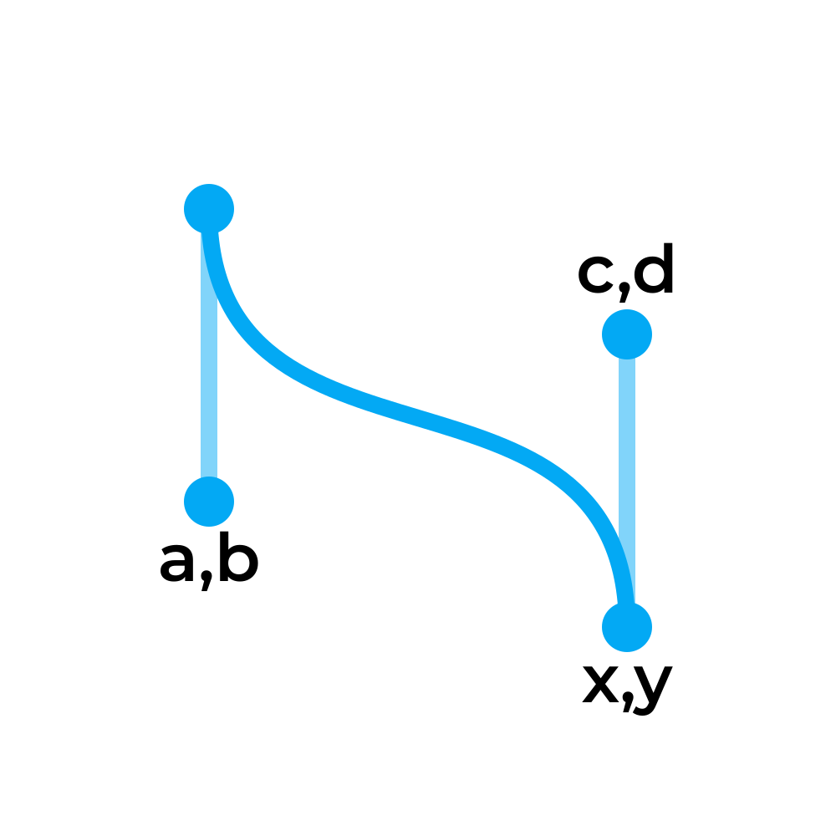
Curve to
C a b c d x y
Notes:
The "C" command draws a curve with two control (handle) points from the current point to the specified point. If you've ever tried to draw a curve in a program like Inkscape or Illustrator, you are probably familiar with the "handles" on each point. The best way to understand how control points behave and form curves is to just play with them in one of these programs.
Tip: If you want to connect two curved segments smoothly without any visible joint, make sure that the slopes/angles of the two connecting control point tangent lines are the same.
https://en.wikipedia.org/wiki/B%C3%A9zier_curve#Constructing_B%C3%A9zier_curves
https://www.joshwcomeau.com/posts/dynamic-bezier-curves/

Slide 51
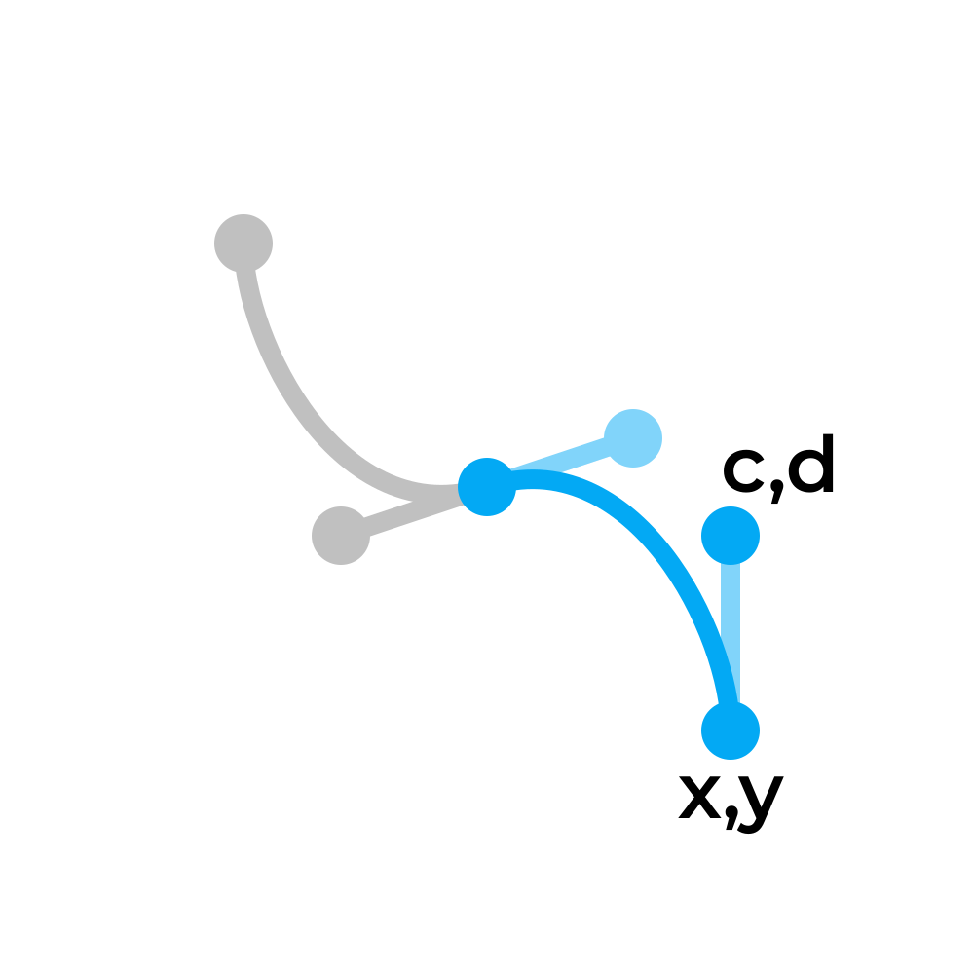
Curve to - shorthand
S c d x y
Notes:
The "S" command is a quicker way to draw a series of bezier curves in succession. The command essentially does the same thing as the "C" command, except that the "a b" control point is assumed to be a reflection of the "c d" control point of the previous curve.
This command should only be used right after a "Q" command or another "S" command.
This is how curve pen tools in programs like Inkscape and Illustrator typically work, where you click and drag to define the first control point of the next curve and the second control point of the previous curve at the same time.

Slide 52
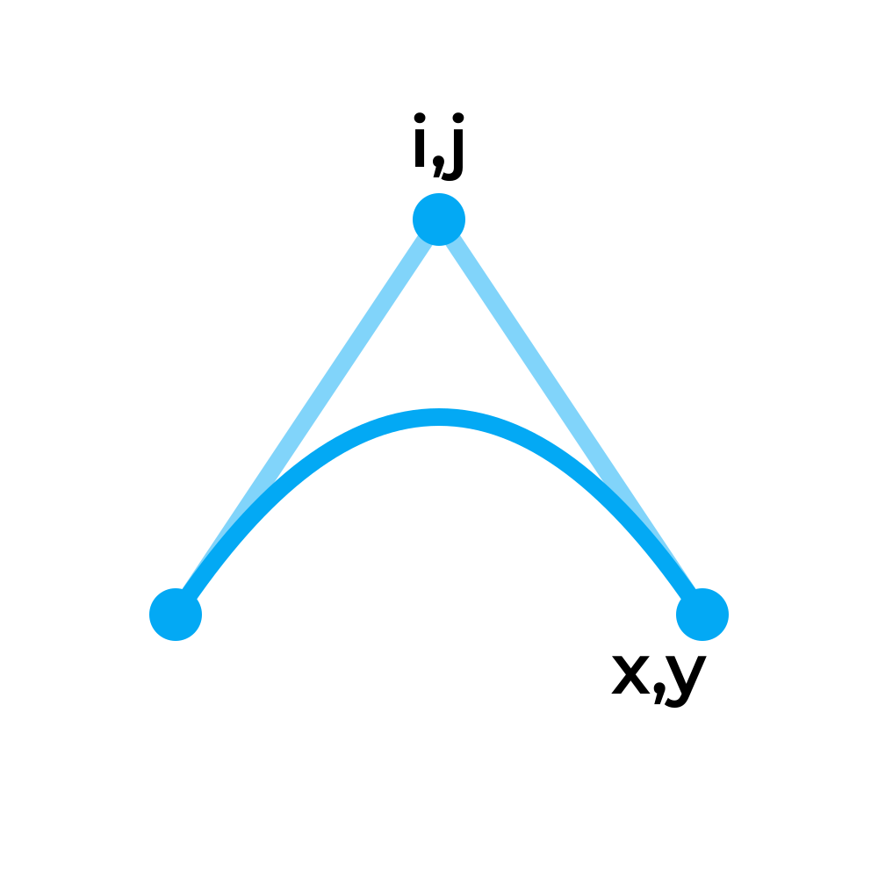
Quadratic to
Q i j x y
Notes:
The "Q" command draws a curve with one control (handle) point from the current point to the specified point. You can think of it as a simplified version of the "C" command, where both control points are the same point.

Slide 53
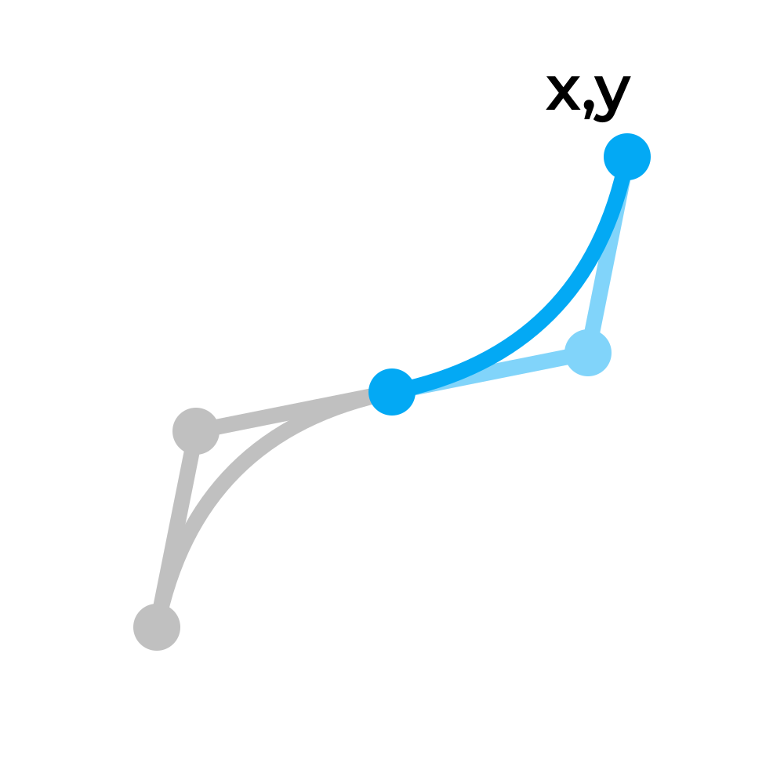
Quadratic to - shorthand
T x y
Notes:
The "T" command is a quicker way to draw a series of quadratic curves in succession. The command essentially does the same thing as the "Q" command, except that the "i j" control point is assumed to be a reflection of the "i j" control point of the previous curve.
This command should only be used right after a "Q" command or another "T" command.

Slide 54

Relative coordinates
M 25 25
h 50
v 30
l -25 25
l -25 -25
z
Notes:
Note that all of the previous commands were shown as capital letters. If you provide a lowercase command letter, coordinates you give it are assumed to be relative to the previous coordinate, instead of relative to the origin of the image (absolute).
This can be very useful when you know the difference between each point better than its absolute position in the overall image. However, if you will want to tweak individual points without affecting all the following points, you should write your coordinates as absolute.

Slide 55
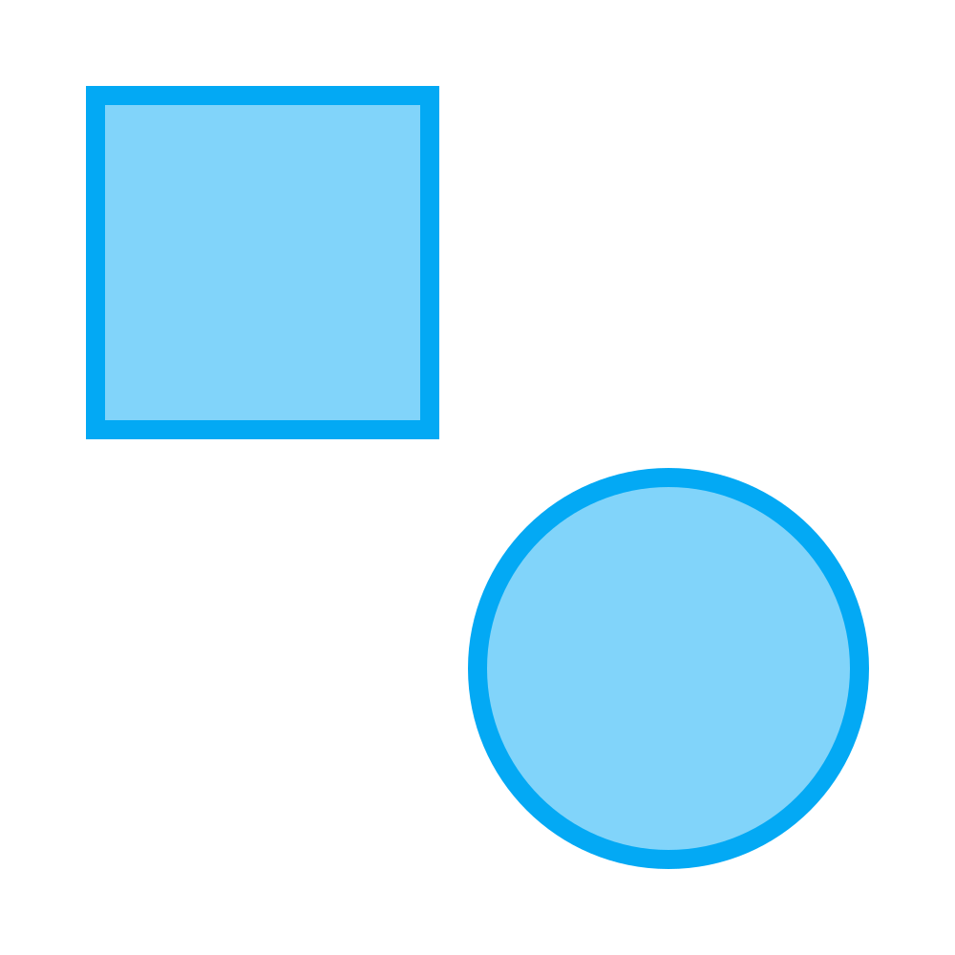
Quirks
M 10 10
l 35 0
0 35
-35 0
z
M 70 50
a 20 20 0 0 1 0 40
a 20 20 0 0 1 0 -40
z
Notes:
If you provide more inputs than are needed for a command, the extra inputs overflow into a new command of the same type. For example, if you write a "line to" command, and keep providing pairs of coordinates without a new command letter, it will simply be parsed as multiple consecutive line commands.
If you are trying to draw a circle in a path, you unfortunately cannot draw it with only one arc command; you must split it up into multiple. It's usually the clearest and simplest to just draw two semi-circles.

Slide 56
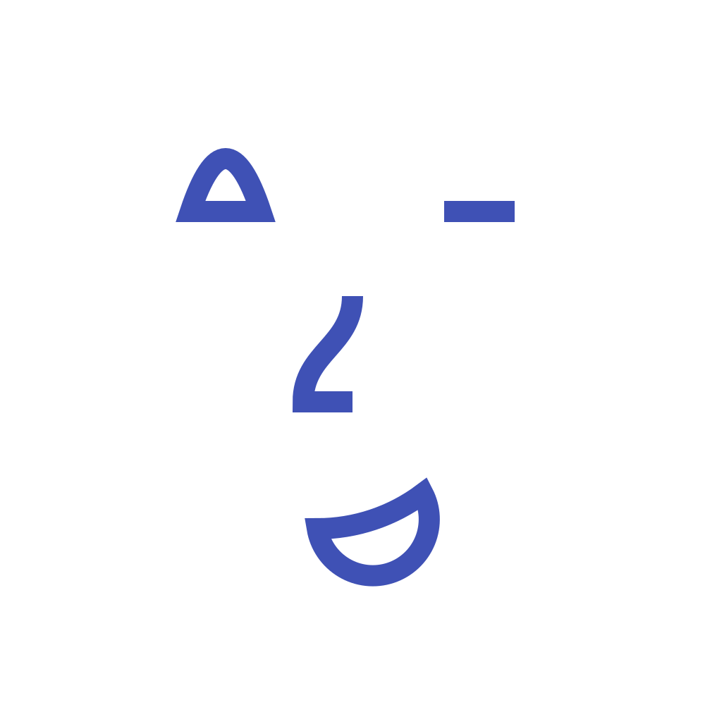
Exercise 4
Notes:
Recreate this SVG on your own using the techniques covered so far. The exact colors, lengths, and dimensions are not important; just try to capture the basic picture.

Slide 57
Groups & Transforms

Slide 58
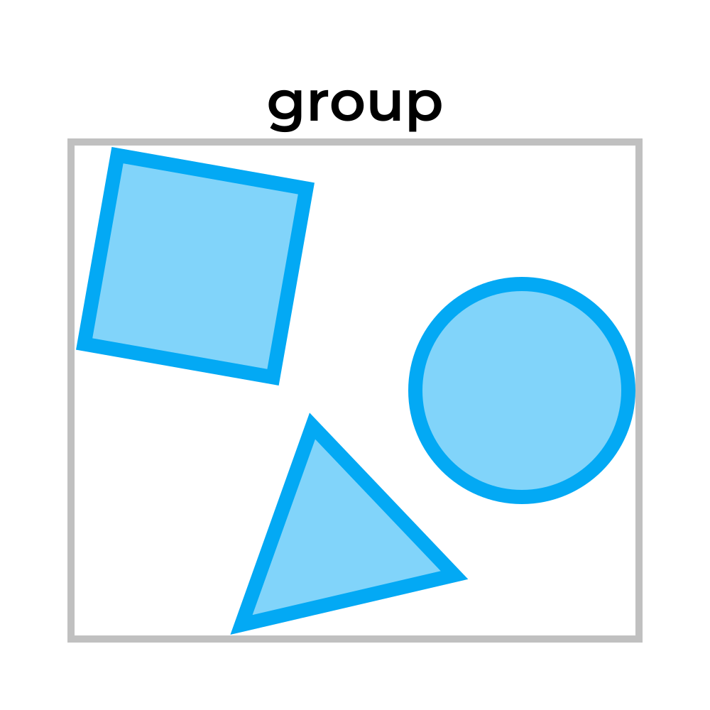
Groups
<g fill="skyblue" stroke="blue">
<rect />
<polygon />
<circle />
</g>
Notes:
Elements can be grouped together and then treated and operated on as a whole, just like in any software that has grouping. Placing elements inside a <g> element groups them together. Groups can be nested within each other, allowing a complex hierarchy of visual components.
Style attributes like fill and stroke can be set once, on the group element, and automatically cascade down to all of the children elements. Transformations can be applied to a group to affect all of the children as if they were a single cohesive element.
SVG editing software usually uses groups as a way to make layers that can be conveniently toggled on/off. Groups may also be used as just a way to divide the document into more readable/manageable sections.

Slide 59

Group opacity
<rect opacity="0.5" />
<circle opacity="0.5" />
<g opacity="0.5">
<rect /><circle />
</g>
Notes:
When the opacity attribute is applied to a group, all of its children are drawn as normal before the opacity is applied. If you draw several overlapping shapes with solid/opaque fills and put them in a group with an opacity, they will become translucent together as a single shape, rather than being individually translucent.
This is a useful trick when the shape you need is drawn more easily with basic shapes than with a multi-part <path> element, and you need it to be transparent.

Slide 60

Transform
<element transform="..." />
"last() third() second() first()"
Notes:
The transform attribute can be applied to an element to translate, scale, rotate, or skew it. The transformations are applied at (or near) the end of the rendering process, meaning that they will transform the element "as is". That is, any stroke, fill pattern, child shapes, etc will be warped.
The attribute takes a series of functions that are applied right to left. Multiple functions of the same type can be specified, and in any order. Arguments can be separated by space or comma.

Slide 61
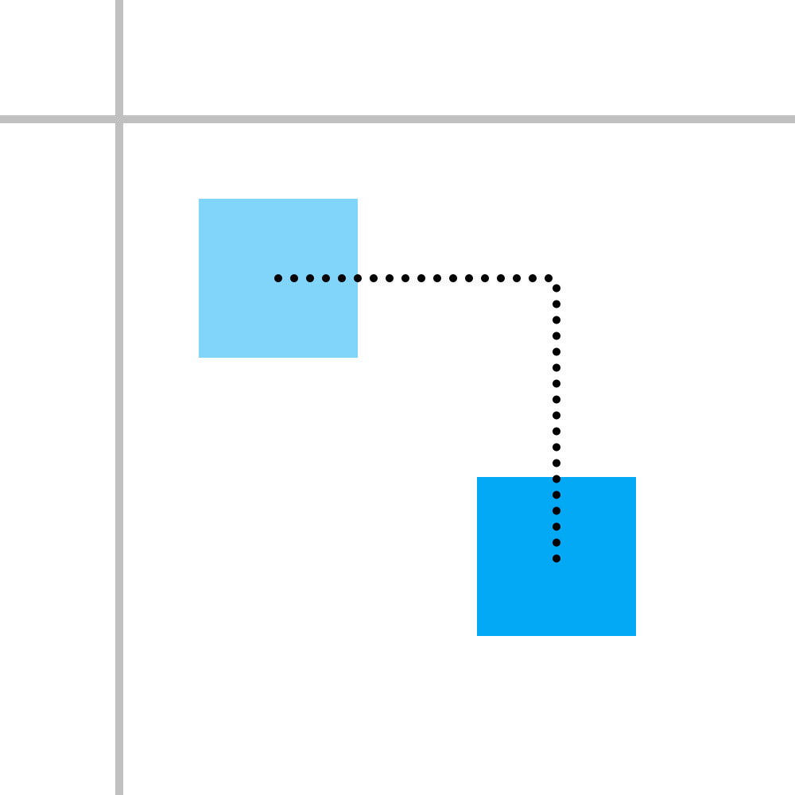
Transform - translate
translate(dx,dy)
Notes:
The "translate" function takes an x and y distance (specified the same way as any other unit) to move the object.

Slide 62
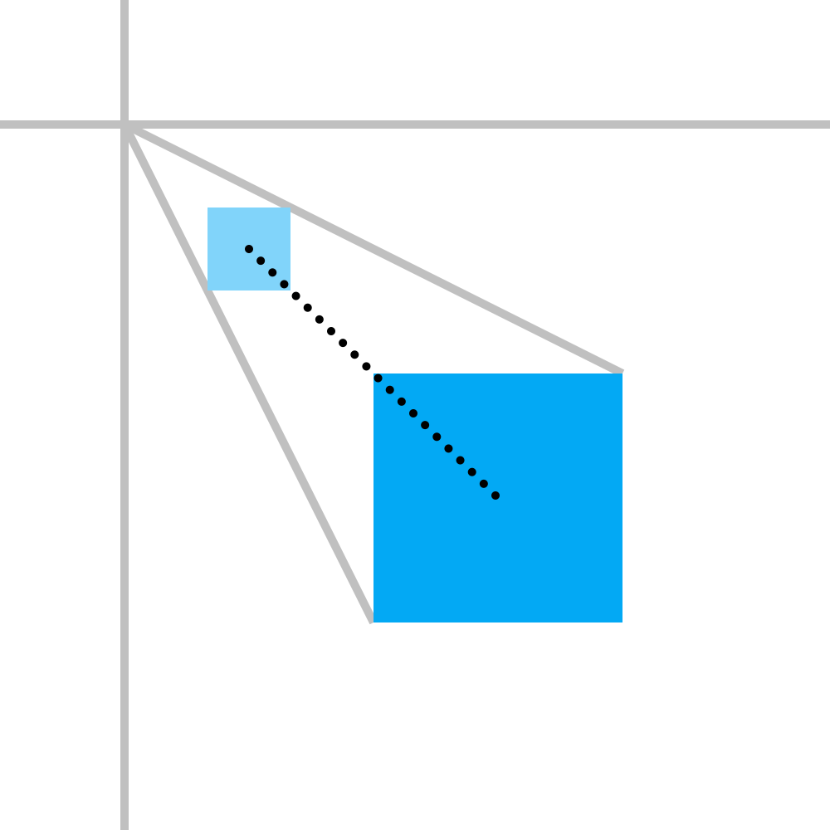
Transform - scale
scale(sx,sy)
Notes:
The "scale" function takes an x and y factor to scale the object by, where 1 is original size, 0.5 is half size, 2 is double size, etc.
If the y factor is not provided, it is assumed to be the same as the provided x factor; ie, a aspect-ratio-preserving scale.

Slide 63
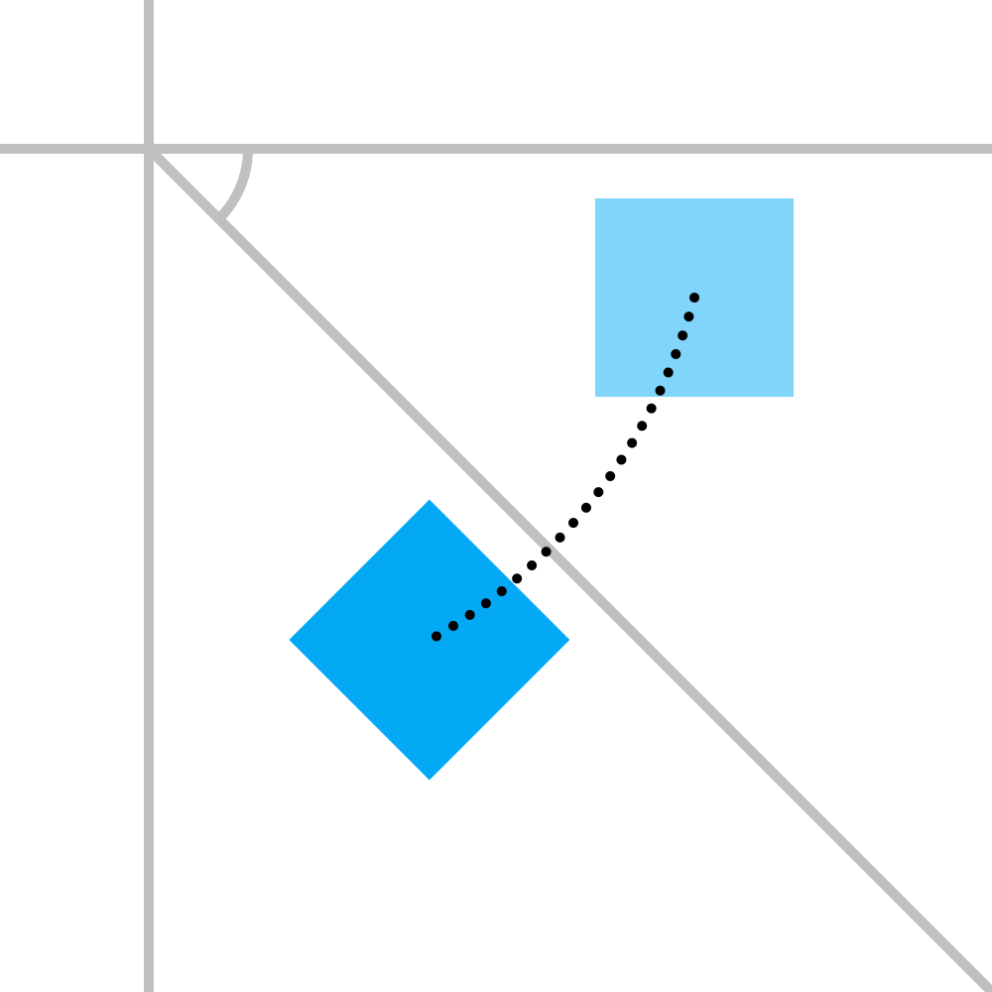
Transform - rotate
rotate(angle,x,y)
Notes:
The "rotate" function takes an angle to rotate the object by (clockwise, from the positive x axis). The function also takes an optional x and y rotation pivot point, which is assumed to be the origin if not provided.

Slide 64
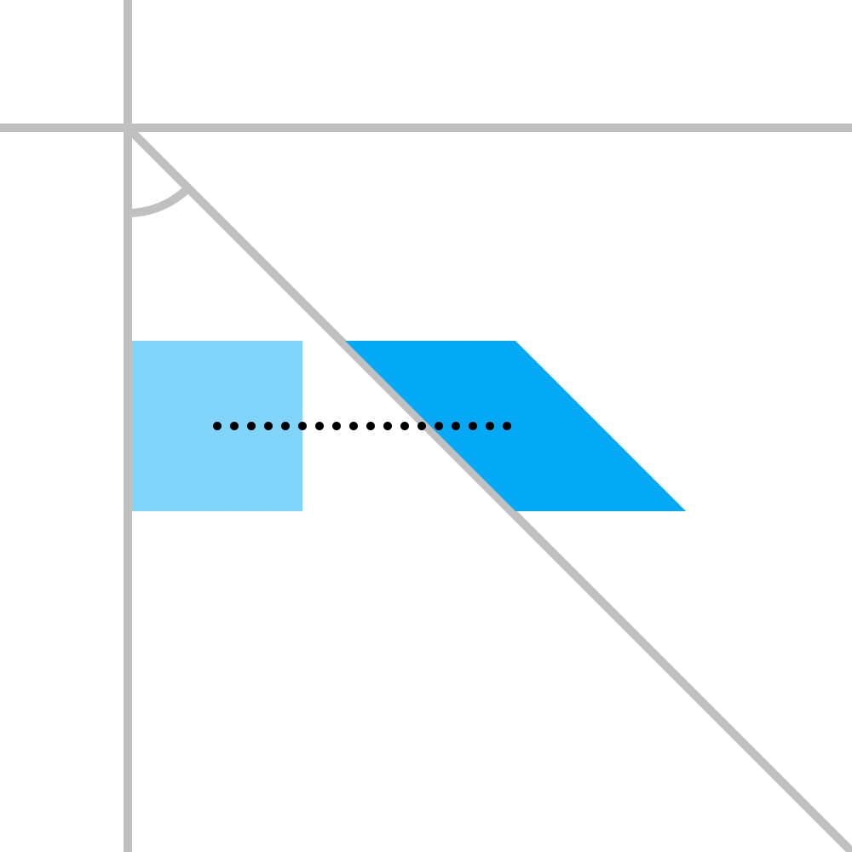
Transform - skew
skewX(angle)
skewY(angle)
Notes:
The "skewX" and "skewY" functions take an angle to horizontally and vertically (respectively) skew the image by. Skewing can be thought of as slicing the image (horizontally with skewX or vertically with skewY) and splaying those slices out like a deck of cards.
The x skew can be visualized as rotating the vertical axis (counter-clockwise) by an angle, and the y skew as rotating the horizontal axis (clockwise).

Slide 65
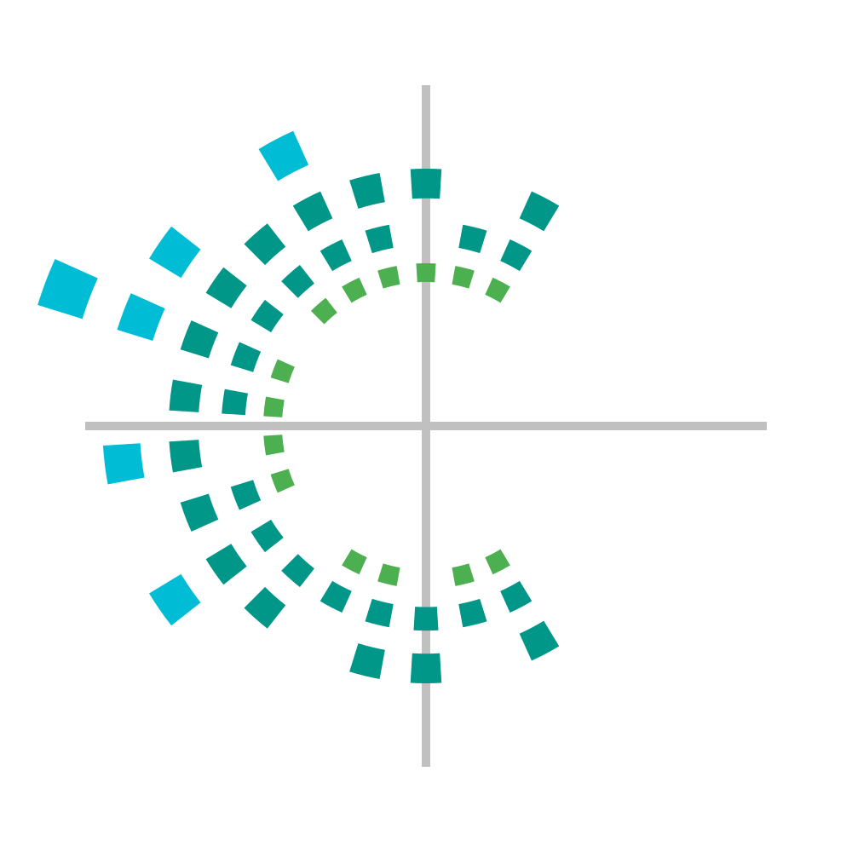
The woes of transform
Notes:
Transform operations are done relative to the origin of the image. If you wish to transform an element around its center, you unfortunately must go through a tedious process: first translate the object such that its center is at 0,0, apply your rotation/scale/skew, then translate it back to its original position.
There is an attribute transform-origin that can change which absolute point the element is transformed around, but unfortunately it is not reliable on all devices and softwares. Also, it only allows you to set the transform origin relative to the viewbox (eg, center of the view), not around the center of a particular element.
As such, sometimes it's a good idea to simply draw shapes around the origin from the start, then translate them to the desired location. This also often makes the coordinates more symmetric, making them easier to read and change later.

Slide 66

Exercise 5
Notes:
Recreate this SVG on your own using the techniques covered so far. The exact colors, lengths, and dimensions are not important; just try to capture the basic picture.

Slide 67
Special Concepts

Slide 68
Classes and id's
<element id="unique_thing" />
<element class="generic_type" />
<element class="generic_type" />
<element class="generic_type another_type" />
Notes:
The id and class attributes can be used to name/label elements so you can refer to them elsewhere in the document. There is a wide range of valid syntaxes for these names, but it is convention to only use letters, numbers, underscores, or dashes. Notably, the names cannot start with a number.
An id is meant to reference a specific instance of an object; an object that is unique, and only appears once in the document.
A class is meant to reference a type of object that there are multiple instances of throughout the document. You can also apply several classes to a single object by separating the class names by space.
You will see SVG editing software output a lot of generated ids and classes. They normally not very descriptive or useful, and can often be removed.

Slide 69
CSS and the <style> tag
<style>
element {
attribute: value;
}
#id_name {
}
.class_name {
}
</style>
Notes:
Recall that SVG is defined by the same people who define web standards such as HTML and CSS. As such, there is a lot of crossover and overlap between the standards, making it very confusing for people trying to learn them.
Adding a <style> element to an SVG allows you to apply CSS styles to certain elements in the image. A CSS style, for the purpose of an SVG, is an alternative way to set an attribute. Many of the attributes that have been covered in this presentation so far can also be applied as a CSS style, with a slightly different syntax, as illustrated above. The benefit of this approach is that you can apply properties to multiple elements in just one spot.
The special characters that precede the names are known as "CSS selectors". There are many more advanced selectors, but you will likely only ever use the id # and class . selectors. Without a preceding character, you are referring to the type of element itself; ie the "tag name". For example, text { fill: red } would apply a red fill to all <text> elements in the document, whether they have ids/classes or not.
Note that the <style> element itself is not visible; it is a definition element. There are several other types of definition elements like this as well.

Slide 70
Valid <style> attributes, and exceptions
fill: red;
stroke: blue;
stroke-width: 10;
...
transform: translate(10px,5px) rotate(45deg) skewX(10deg);
font-size: 12pt;
letter-spacing: 2px;
Notes:
The attributes that can be applied with styles are referred to as "presentation attributes". In general, they are the properties that describe the "style" of elements, but not their geometry. The attributes covered in this presentation that can be applied with styles are:
fill, stroke, opacity, stroke-width, stroke-linecap, stroke-linejoin, stroke-dasharray, stroke-dashoffset, font-family, font-size, font-weight, font-style, text-decoration, letter-spacing, text-anchor, dominant-baseline, baseline-shift, transform
Note some small differences: the transform attribute requires specifying units, and requires a comma between function parameters (a space is not valid). The font-size and letter-spacing attributes also require units. In general, if something is not working, check to see if the CSS version of the attribute requires a different syntax than the SVG version.
CSS also has significantly more transform functions than SVG, like "perspective" and "rotate3d". But use these in SVG with extreme caution; they are not likely to be supported in many programs.

Slide 71
Inline styles
<element attribute="value" />
<style>
#some_element {
attribute: value;
}
</style>
<element style="attribute: value; attribute: value; attribute: value" />
Notes:
To add more confusion, CSS styles can also be defined "inline", right on the element, in a style attribute. This makes 3 ways you can specify the appearance of objects:
1) Attributes on the object
2) CSS styles in <style> tag
3) Inline CSS styles
For most purposes, these will all yield the same result. The main difference is that they have different priorities when there are overlapping/conflicting properties for a particular element.
There is no consensus about which of these to use and when. SVG editing software will often generate inline CSS styles, perhaps because they have the highest/final priority. However, it is the opinion of this author that you use approach 1) for consistency and simplicity.
https://stackoverflow.com/a/36755226/2180570

Slide 72

<style> example
<style>
text { font-family: Pacifico; }
#company { font-size: 14pt; }
.blue { fill: blue; }
.dot { opacity: 0.5; }
</style>
<text id="company" class="blue">
Twiddr
</text>
<circle class="blue dot" />
<circle class="blue dot" />
<circle class="blue dot" />
Notes:
Here is an example of using a combination of CSS selectors: tag name, id name, and class name.
Special trick: if you want to use an online font but don't want to install it on your system, you can dynamically import the font from a url like this:
<style>
@import url('https://fonts.googleapis.com/css?family=Pacifico');
#some_element { font-family: Pacifico }
</style>
This requires an internet connection, though, and should be used cautiously.

Slide 73

Gradients
<defs>
<linearGradient
id="rainbow" x1="0%" y1="100%" x2="100%" y2="0%"
>
<stop offset="0%" stop-color="red" />
...
<stop offset="50%" stop-color="blue" />
...
<stop offset="100%" stop-color="orange" />
</linearGradient>
</defs>
<rect fill="url('#rainbow')" />
Notes:
The <defs> tag, like the <style> tag, is used to define special things that aren't shown in the image but can be referenced elsewhere in the document. Gradients are one such thing.
Gradients can be used as fills or strokes in place of a solid color. There are two kinds of gradients you can specify: <linearGradient> and <radialGradient> (unfortunately there is no angular gradient). You can specify the start and stop position of the gradient in terms of % (relative to the dimensions of whatever object it is applied to). You can add any color "stops" that you need, specifying their % through the gradient, their color, and their opacity if needed. There are several other parameters available to tweak the appearance, but these are the most commonly used.
To apply a gradient to an object, first give the gradient an id, then set the fill or stroke of your object to "url('#the_id')".

Slide 74
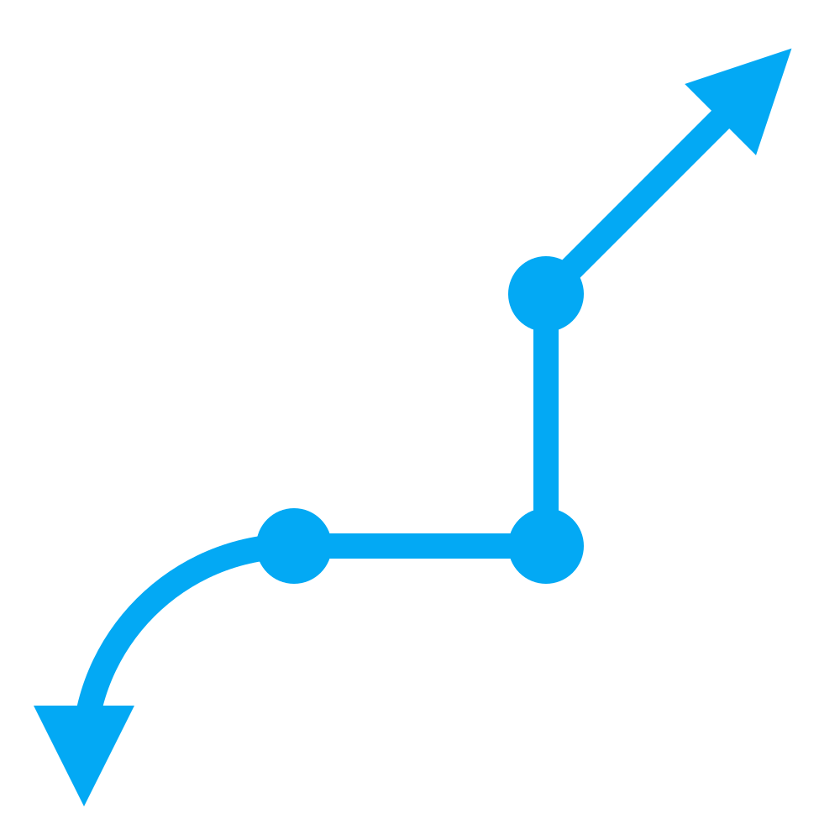
Markers
<defs>
<marker id="arrow" orient="auto-start-reverse">
...
</marker>
<marker id="dot" orient="auto"> ... </marker>
</defs>
<path
marker-start="url('#arrow')"
marker-mid="url('#dot')"
marker-end="url('#arrow')"
/>
Notes:
Markers are another thing that go in the <defs> tag.
Markers are a way to define arrow heads or point markers on the stroke of lines, polylines, polygons, or paths. They can be any shape you want, and can be placed at the start of a stroke, the end of a stroke, and at the mid-points (where separate segments join) of a stroke: marker-start, marker-end, and marker-mid, respectively.

Slide 75
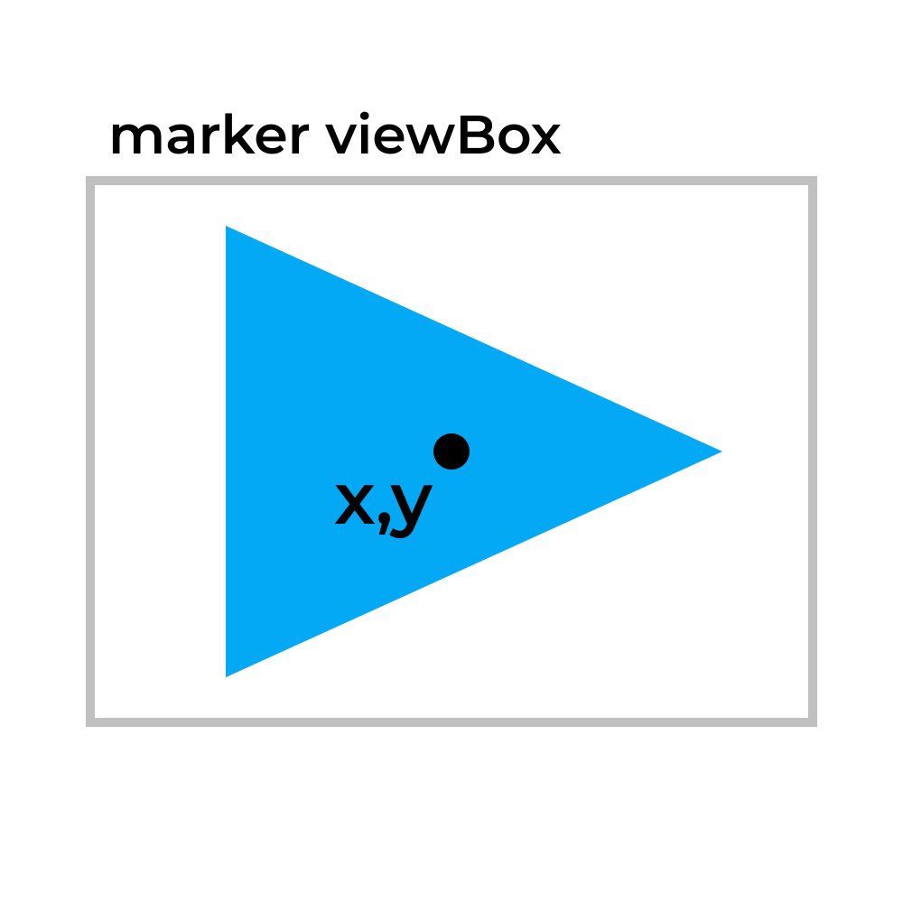
Markers
<defs>
<marker
id="arrowhead"
viewBox="0 0 10 8"
refX="5"
refY="4"
markerWidth="5"
markerHeight="4"
orient="auto-start-reverse"
>
<polygon points="... triangle ..." />
</marker>
</defs>
Notes:
The way markers are defined are essentially as their own mini-SVG within the main SVG. You specify a viewbox attribute for the marker shape, as well as a width and height. The viewbox determines the visible area and coordinate space, and the width/height determine the resulting size that the area is scaled to.
One difference, though, is that the marker width and height, by default, are defined as multiples of the stroke that the marker is attached to. For example, if the marker width and height are set to 5, and the stroke using the marker has a width of 3, the resulting size (in SVG units) of the marker will be 15x15. You can make a marker an absolute/constant size by changing the markerUnits attribute.
You also must specify a reference point, which is the point in the marker's viewbox that gets pinned to the segment start/end point.
By default, markers will not rotate. To automatically rotate markers with the stroke, set the orient attribute to "auto". This aligns the positive x axis of the marker viewbox to the angle of the stroke at the point where the marker is attached. "auto-start-reverse" will rotate the marker like "auto", except the marker at the start of the stroke will be rotated an extra 180 degrees. This is likely what you will want most of the time.
Unfortunately, the fill and stroke color of a marker must be set manually, and cannot be made to automatically match the color of the stroke it is attached to. This may change in future versions of SVG.

Slide 76

Exercise 6
Notes:
Recreate this SVG on your own using the techniques covered so far. The exact colors, lengths, and dimensions are not important; just try to capture the basic picture.

Slide 77



Beyond...
<title>, <desc>, and other metadata
patterns
clips and masks
evenodd fill rule
reuse objects
filters (blur, shadow, blend, sepia, etc)
animations
embed raster images, HTML, SVGs, etc
aspect ratio and overflow control
Notes:
There are many other advanced features SVG has to offer; too many to cover in a single presentation:
- All sorts of metadata can be embedded that can serve various purposes for users and editing software
- Custom patterns (eg checkerboard) can be defined and used as fills and strokes
- Shapes can be cut out of and into other shapes using clips and masks
- You can draw holes into single shapes using the special "evenodd" fill rule
- For images with a lot of duplicate objects, you can define an object once and reference it other places in the image
- You can design custom filters to create all sorts of interesting visual effects
- Presentation attributes can be animated with CSS keyframes to make cool animations
- Various external sources can be embedded into SVGs, including raster images, HTML elements, and even other SVGs
- You can control how your SVG should be stretched to fit its destination container, and whether it should overflow outside its boundaries

Slide 78
Conclusion
Notes:
SVG is a giant and complex specification. What has been covered in this presentation is hopefully 90% of what you will ever need, but is still only the tip of the iceberg in terms of the amount of features and concepts that SVG has.
When you Google for help, or when you open a software-generated SVG, you will likely see many things you don't know. This is okay and normal, even for people who have worked with SVG a lot.
You'll run into thing that are legacy: old features that have been deprecated but are still included to support really old software. Always check to see if it's something you really need.
And you'll run into things that are cutting edge: proposed additions to the specification that are very new and not widely supported yet. Always test your images on multiple devices/browsers/platforms to make sure they work reliably.

